Slide 1
This is a PowerPoint about a charity called…

Slide 2
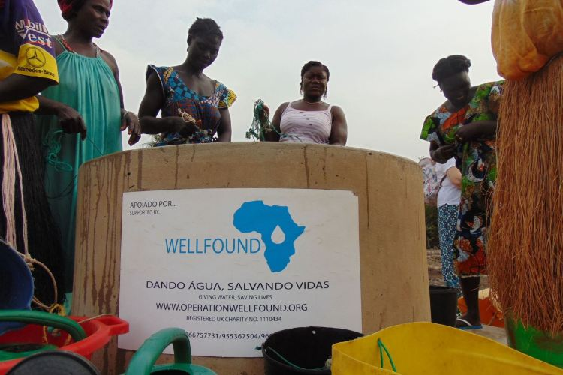
Why is water really important?
Because we need water to survive and more than half our body needs water to function properly

Slide 3
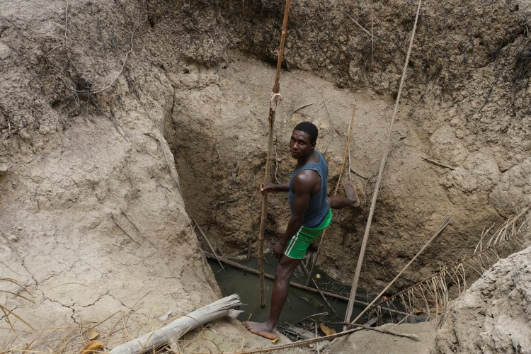
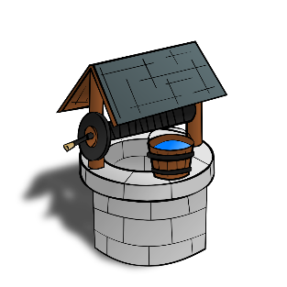
What does the charity do?
.Well found builds wells in Africa so that they have access to clean water which they can drink and cook with.
.The charity helps adults and children.
.They help families build toilets.
.They teach people how to grow food for them to eat and also sell at market.

Slide 4
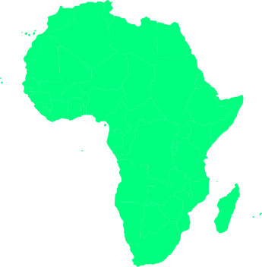
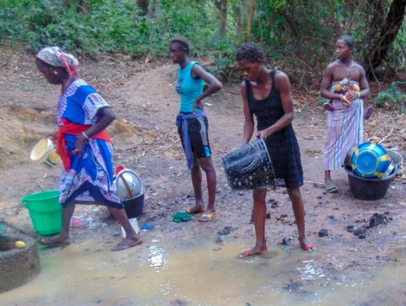
Where do the people live that they support?
They support countries in Africa. These are the 4 main countries they support.
Kenya Senegal Guinea Bissau Burkina Faso

Slide 5
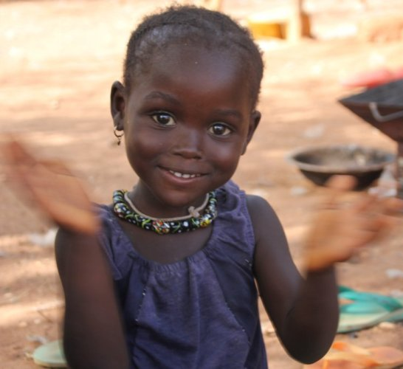
Thank you for listening
If you want to vote for this charity this is the logo.

