Slide 1
Silver Star Cookies
By Sam

Slide 2
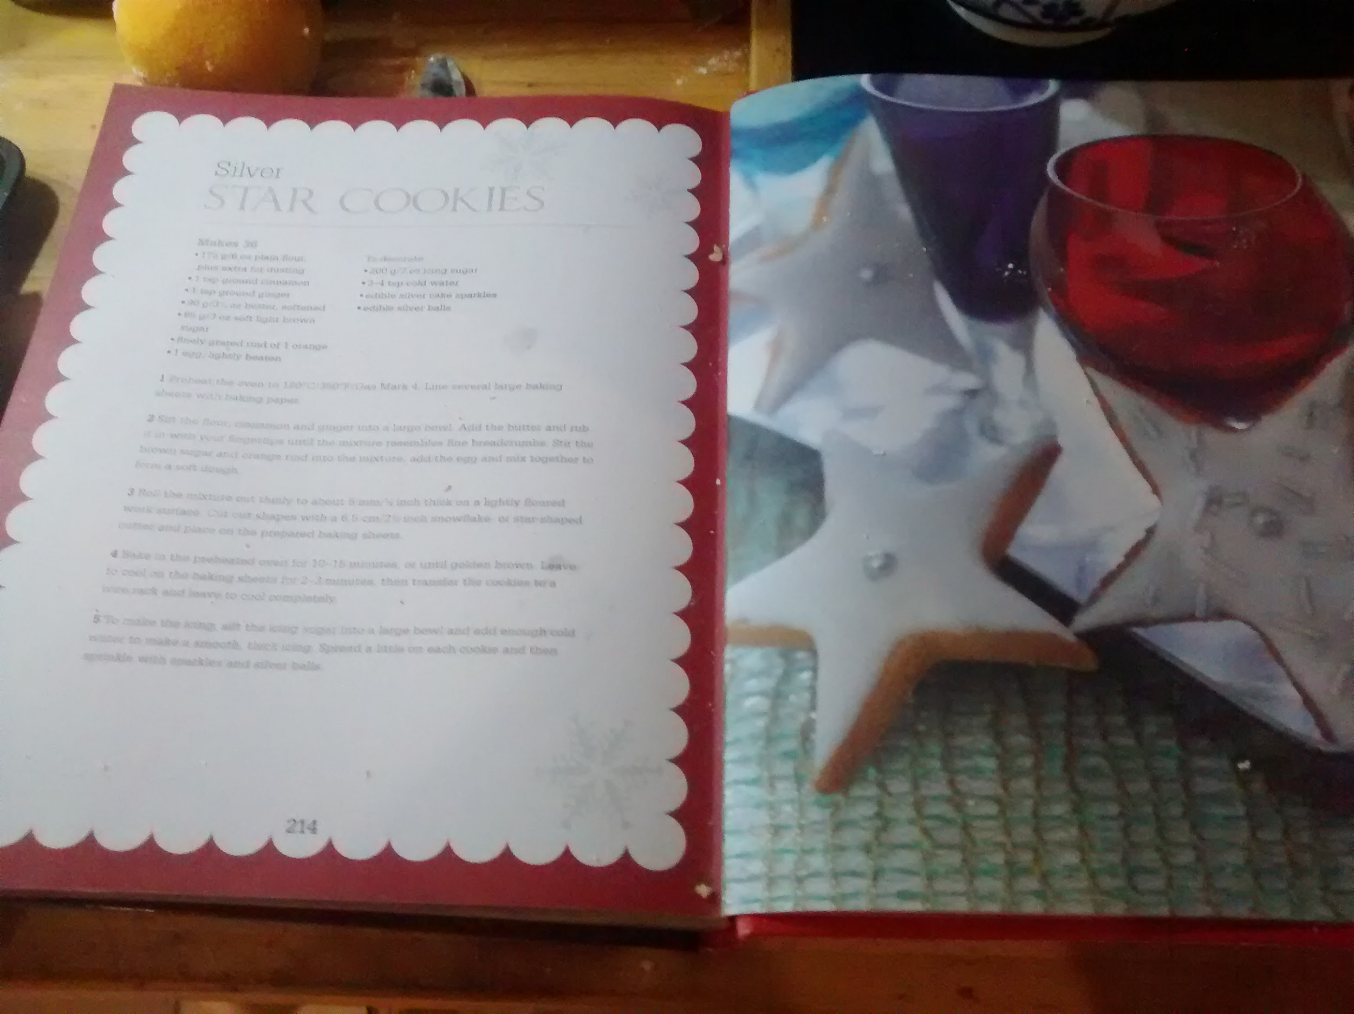
The Cookies.
We picked this recipe out of our Christmas cooking book because it looked quite easy.

Slide 3
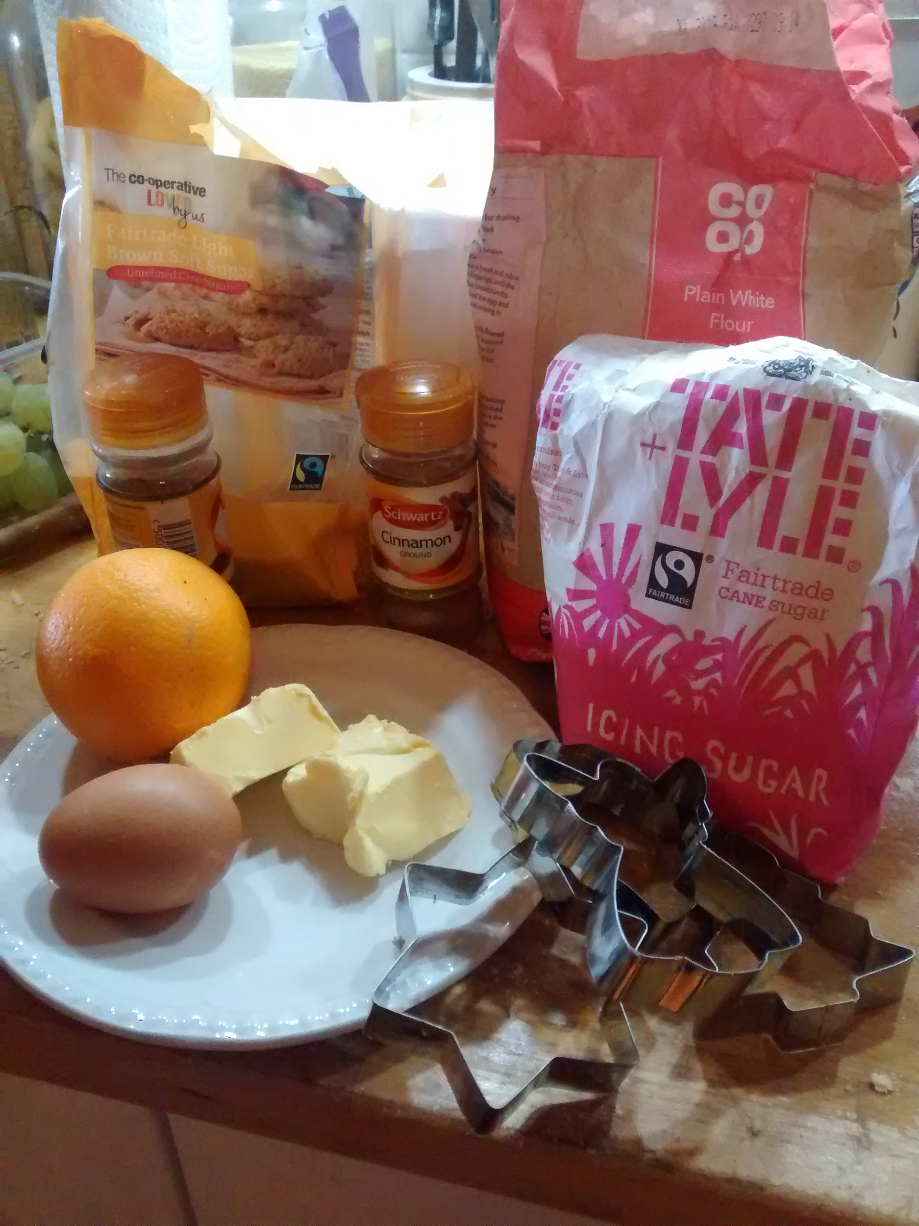
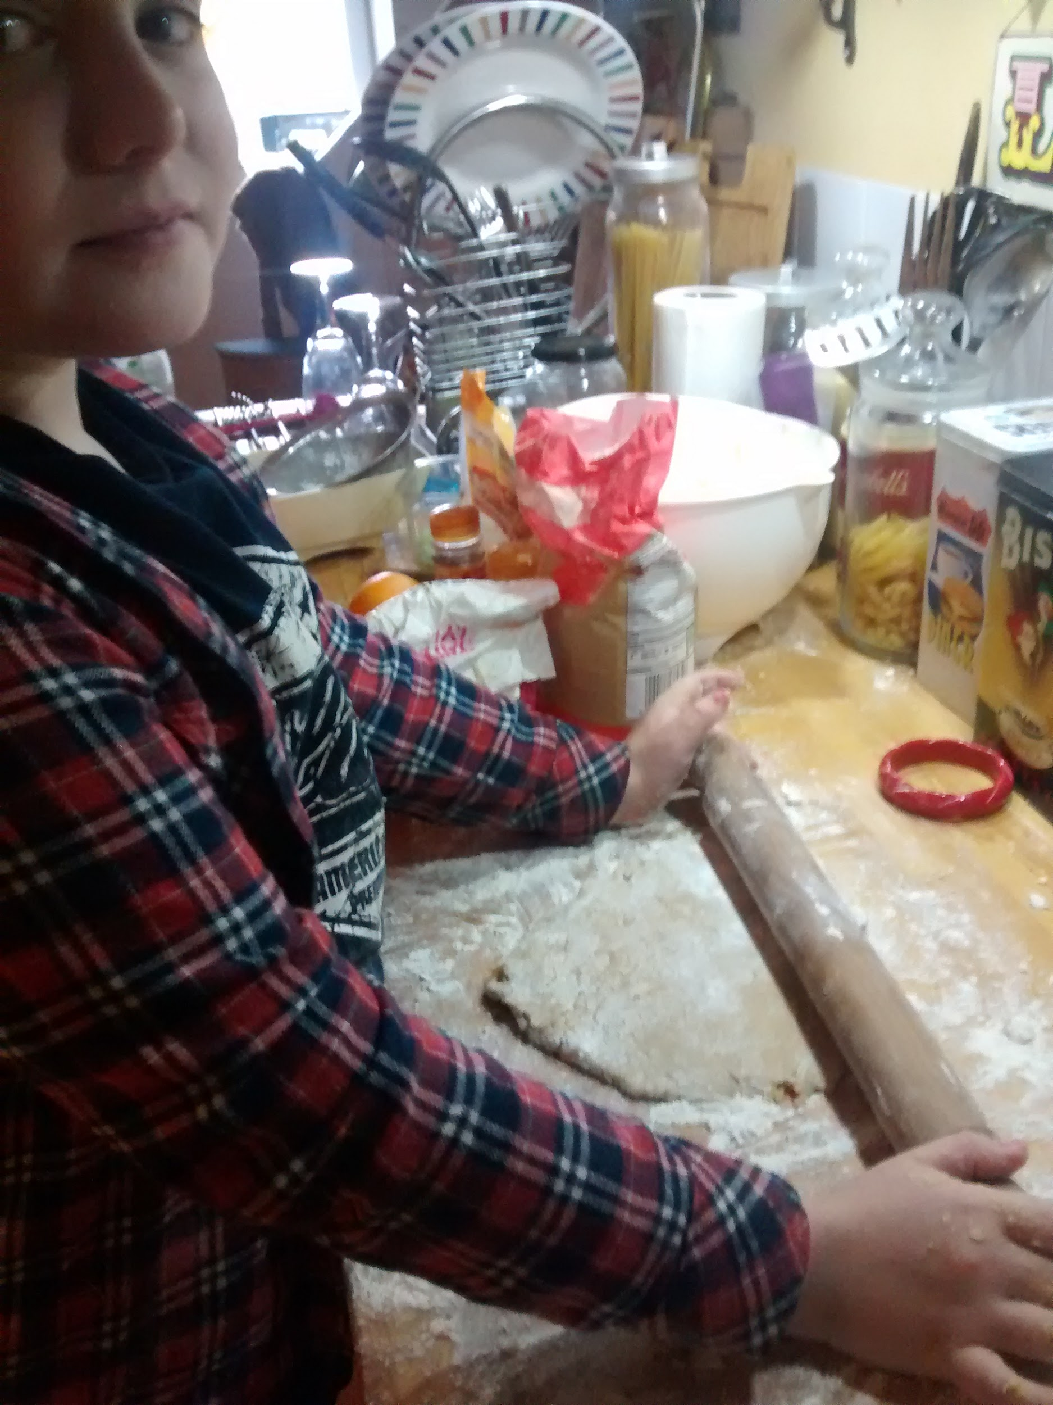
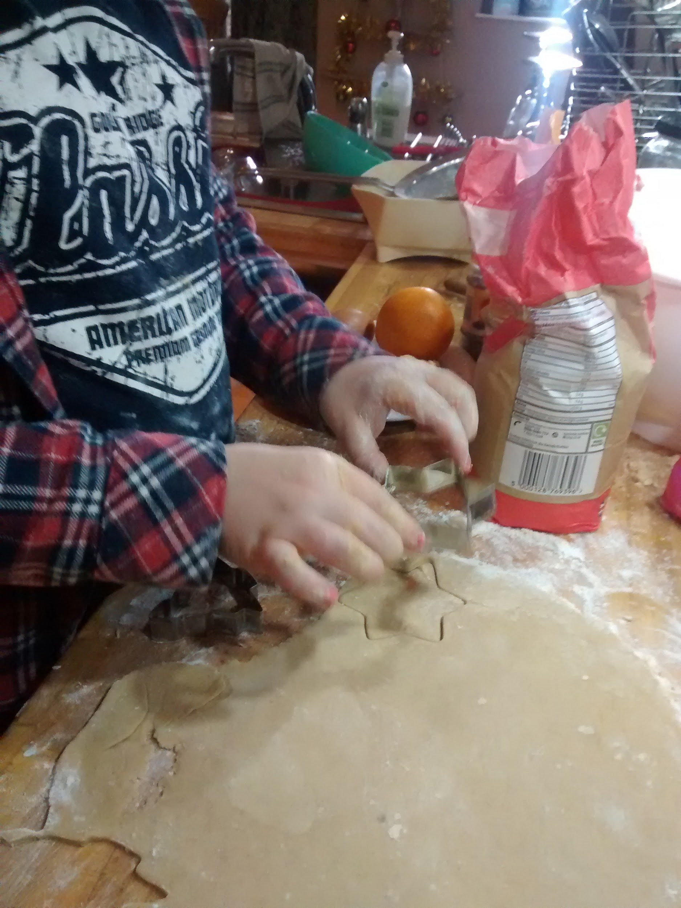
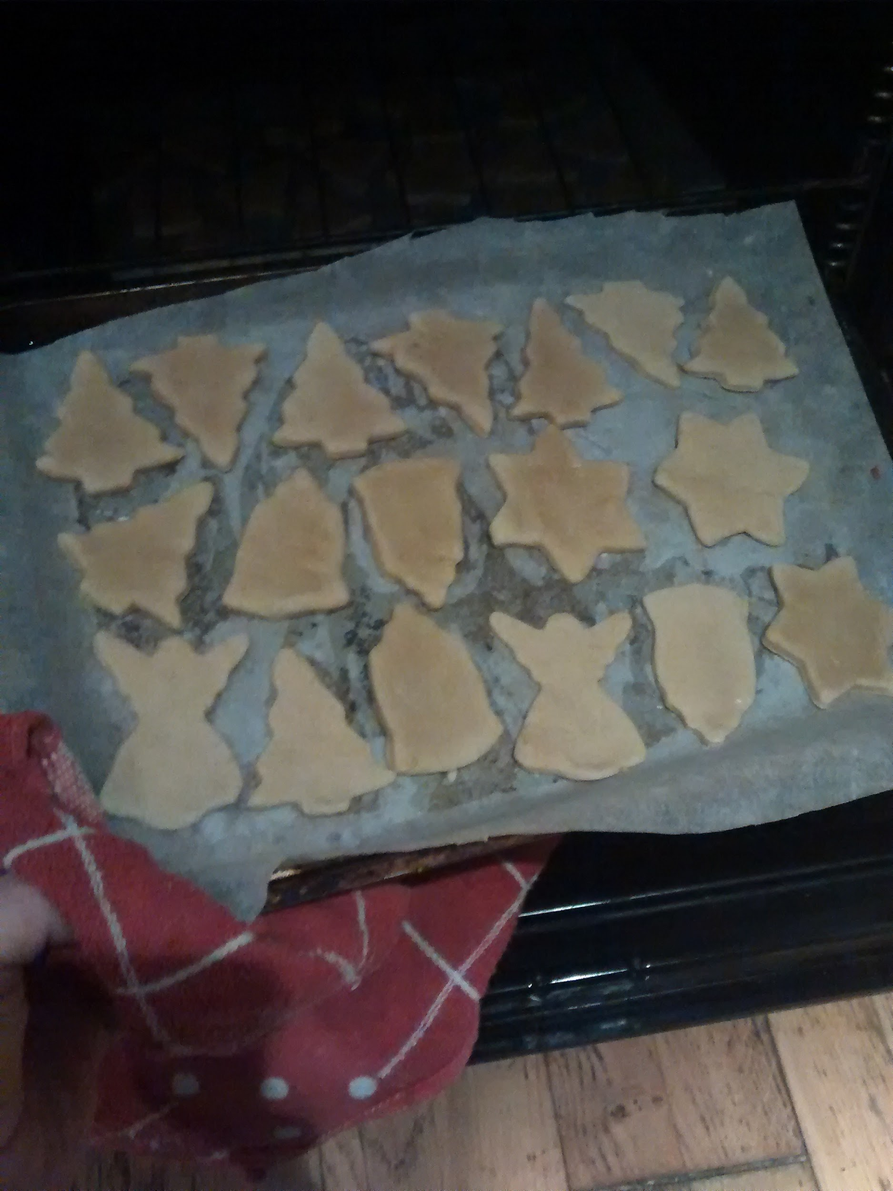
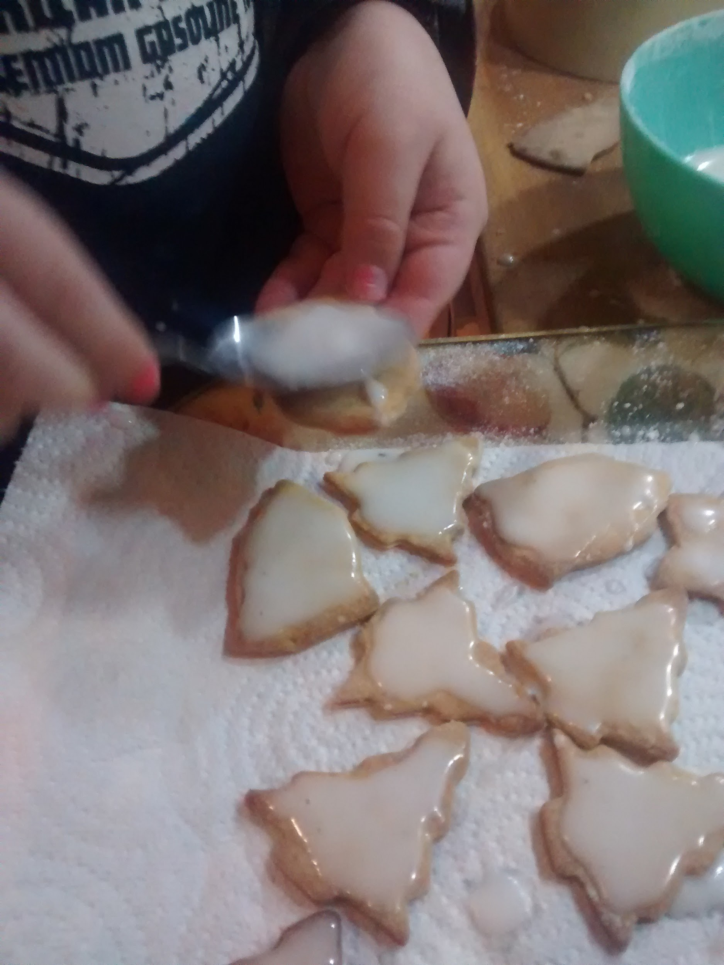
Pictures
These are some photos of the start and finish of the bake.

