Slide 1
Mission for Vision UK

Slide 2
So you can drive, so you can see where you are going, so you can cross the road safely and lots more…
To read, to write, to watch the TV, to play computer games, to learn…
Why is our eyesight so important?

Slide 3
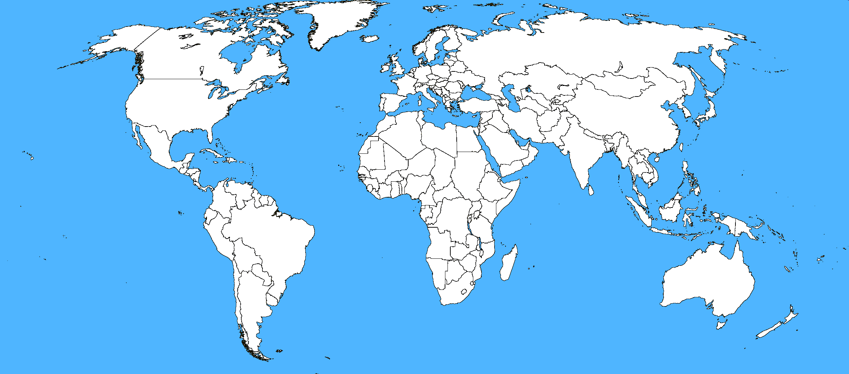
Which countries do they help?

Slide 4
What does the charity do?
They test your eyes
Giving out glasses for people who are in need
Video
Providing protective sunglasses
Organising and funding eye operations.
Giving medication

