Slide 1
Star Wars the movies
By Joshua Emmerton

Slide 2
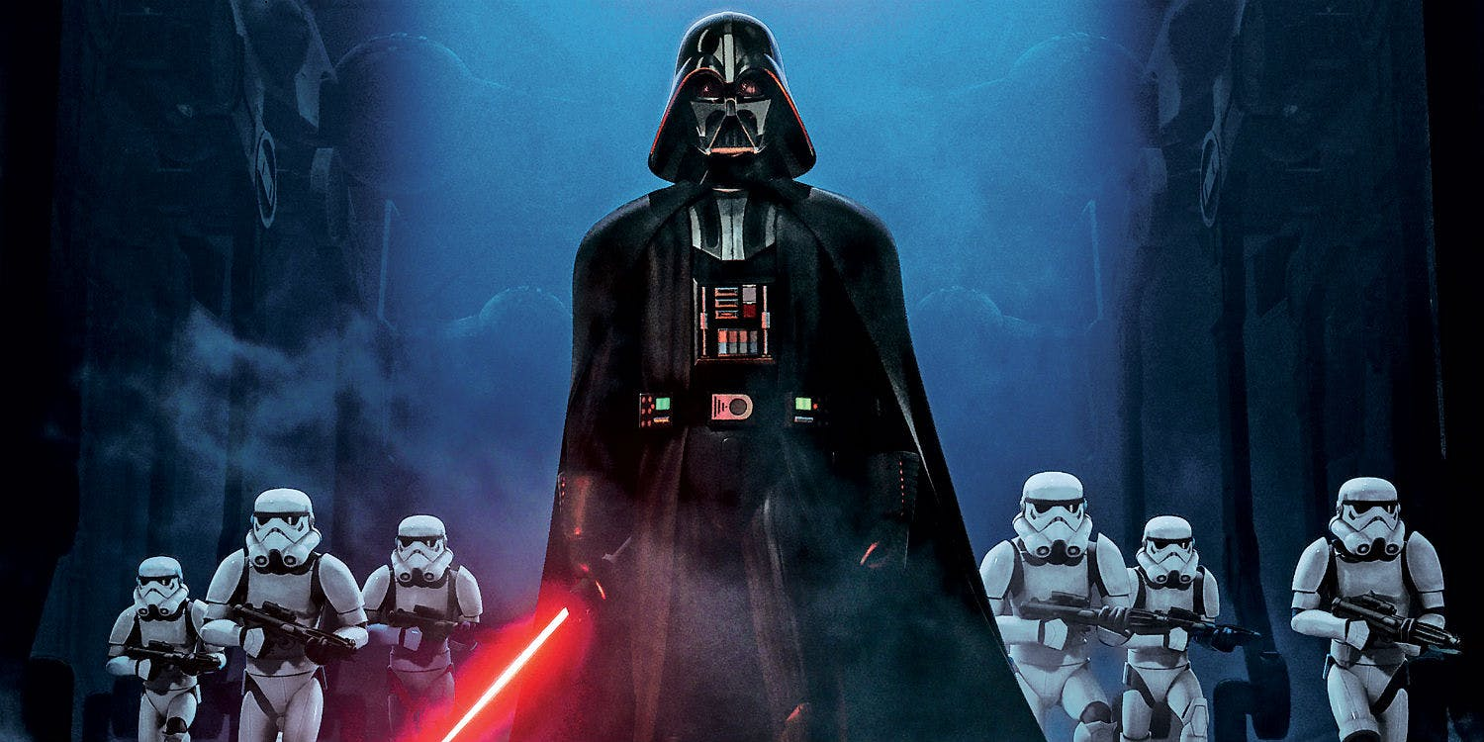
My favourite person – Darth Vader
He has a red lightsaber
Darth vader often wins arguments by force choking
He used to be Anakin

Slide 3
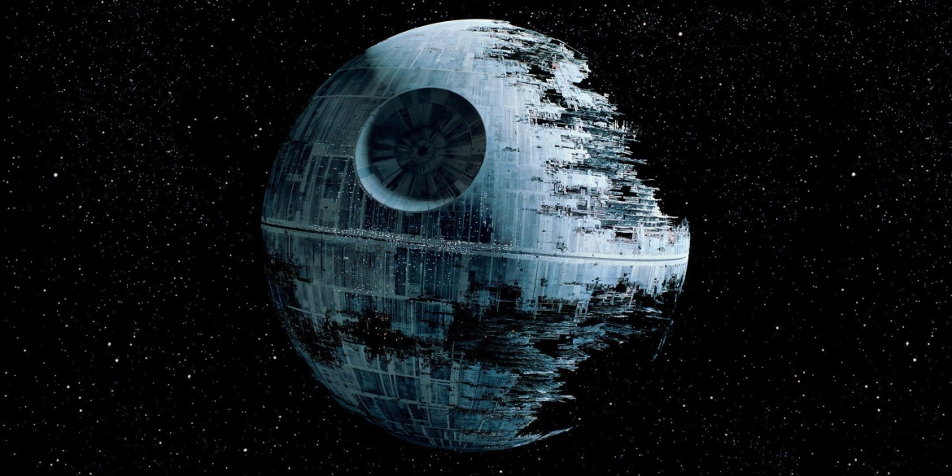
My favourite Weapon – Death Star
It’s the size of a small moon
It can blast a planet to bits
Death star 2 is 99 miles wide

