Slide 1
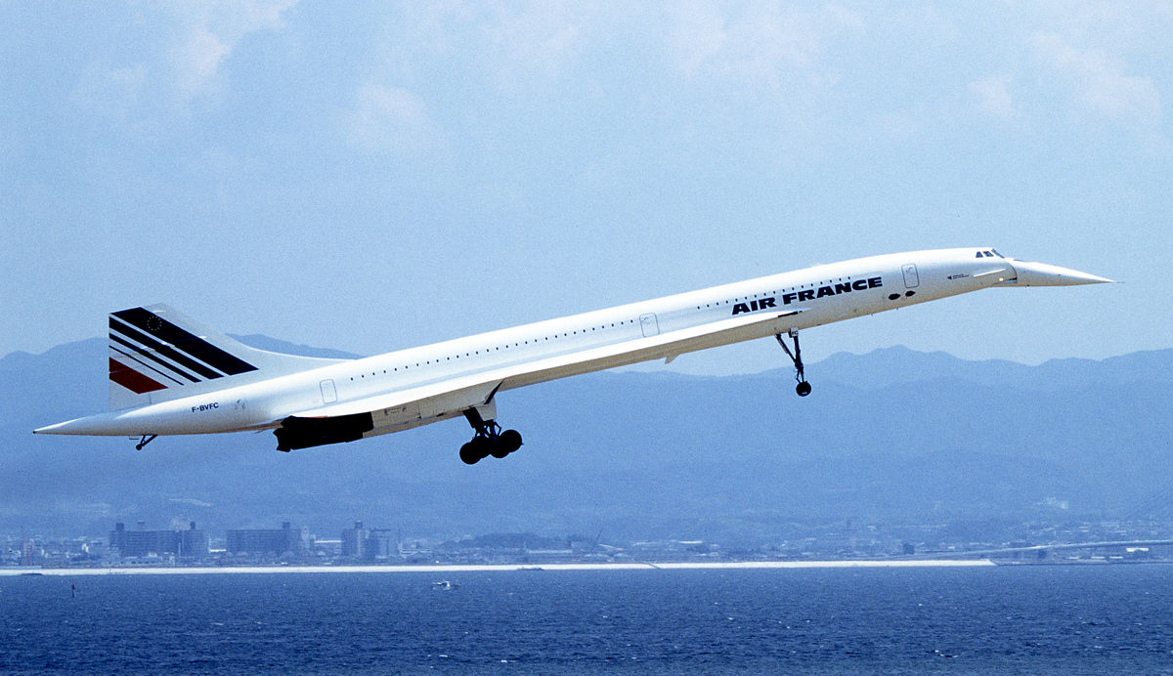
concord
This is a presentation brought to you by Ryan
Hope you enjoy

Slide 2
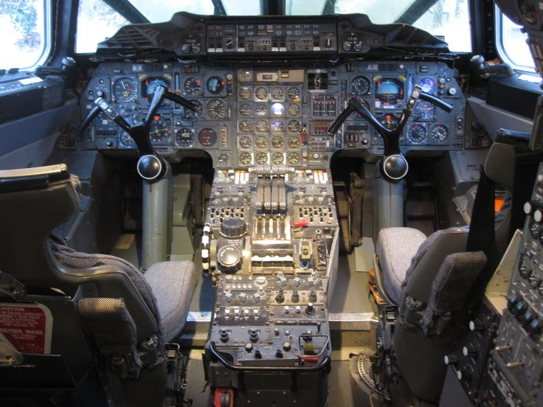
Why I have done a power point about concord
The reason why I have done a power point about concord is because I have been a fan of concord for ages, and I like all other types of aircraft
This is a picture of the cockpit in the Concord☺

Slide 3
Facts about concord…
Concord was developed and built by British and French engineers. The British team was lead by aircraft designer Sir James Hamilton.
Concord first went supersonic on 1 October 1969.
Concord was invented as the first supersonic passenger aircraft.
Concord carried up to 128 passengers and had two captains as seen in the previous picture.
There were 20 Concord’s including 6 non-commercial aircraft.
Concord has a mind blowing top speed of 1350 mph.

Slide 4
…lots more facts to go!!!
The manufacturers of Concord are Airbus, Aerospatiale, BAC Systems, Sud Aviation, British Aircraft Corporation, and British Aerospace.
The First ever flight by Concord was on 2 March 1969.
The entire program cost around £1.3 billion.

Slide 5
Couple more facts to go
B.A. Concord made just under 50,000 flights with more than 2.5 million passengers.
It was the worlds only Supersonic passenger service.
Concord Flight number 001 made its departure from Toulouse on the 2 March 1969.
One more page of facts and this is from B.A. website.

Slide 7
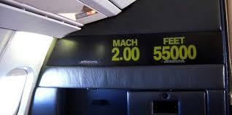
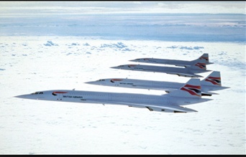
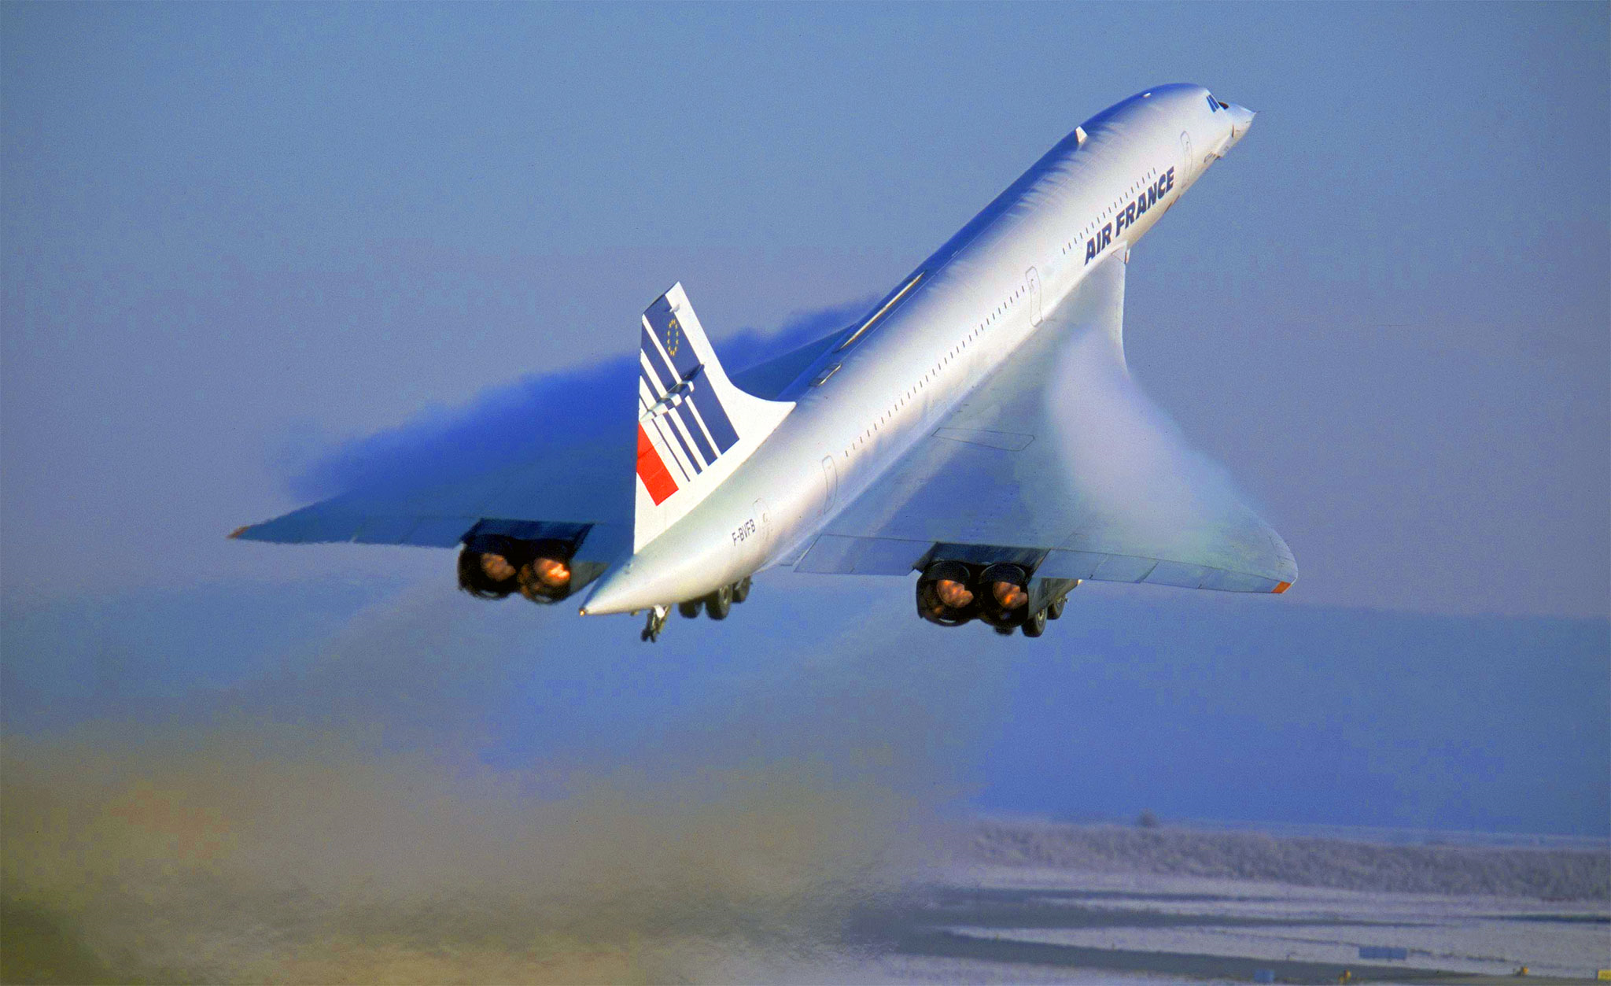
The pictures
It’s a shame that Concord had to retire. (They retired 24 October 2003)
The reason why they retired was because of the horrific crash in Paris. (It crashed into a hotel full of people.)

Slide 8
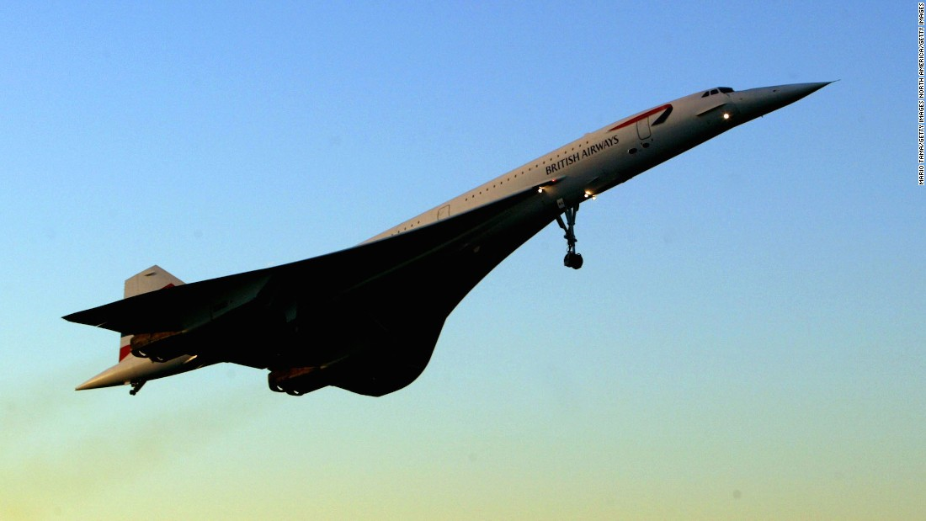

Slide 9
By Ryan Aldred ☺
Thank you for looking at my power
point and I hope you enjoyed it ☺

