Slide 1
My interview

Slide 2
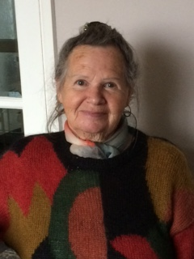
I interviewed my neighbour Ruth
Xmas eve
6pm we get together and have a special meal we always had smoked spare ribs we slaughtered one of our pigs a week before the 24th and smoked it and for pudding we had whipped cream from the alps homemade biscuits and the adults had a glass of liquor then opened our presents and sing.
Father Christmas
We had a female father Christmas called Christkindli two men in black knock on the door on either the 7th 8th or 9th to check children have behaved if they were good you would give them a present to give to the child.
Fun
We had lots of snow we went outside at 11pm and went on a walk more people joined then we had brunch and went to bed at 3 am woke up at lunchtime

