Slide 2
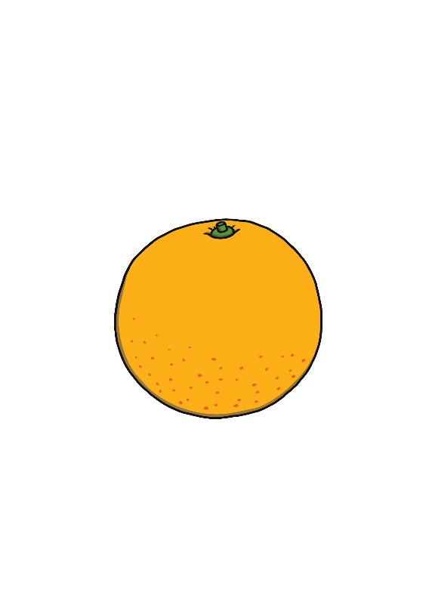
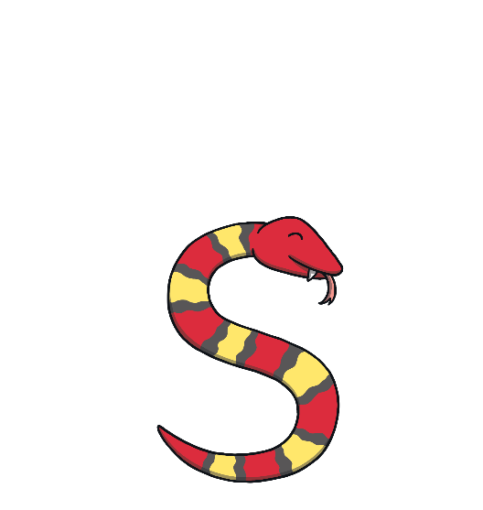
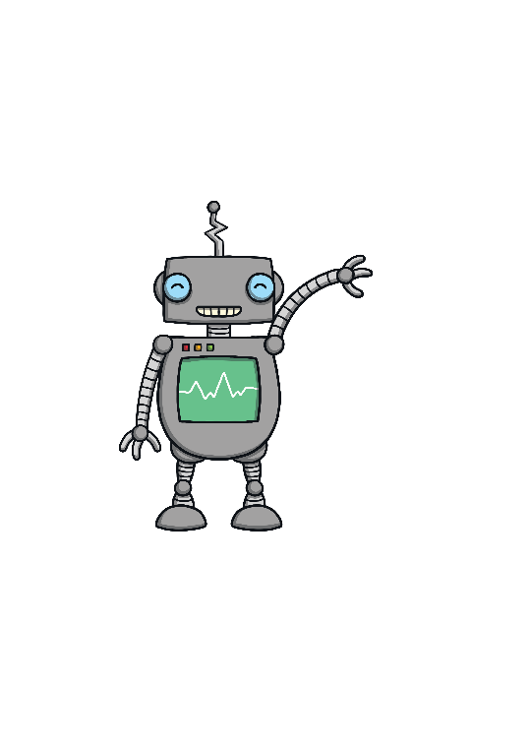
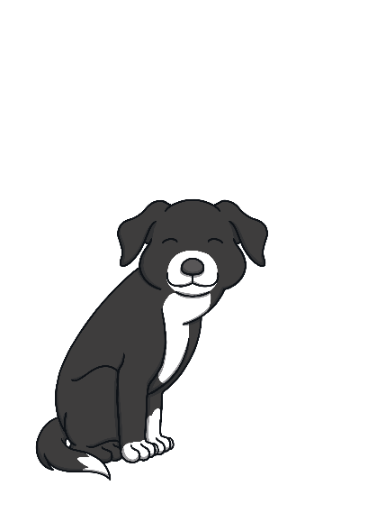
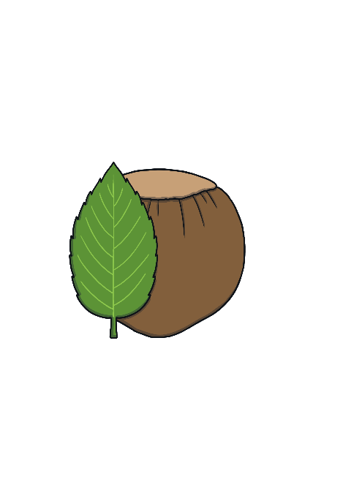
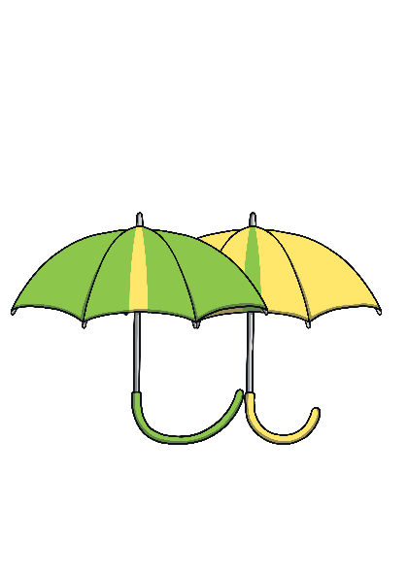
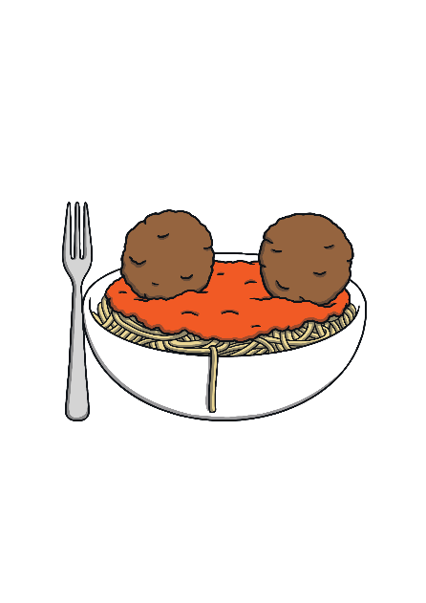
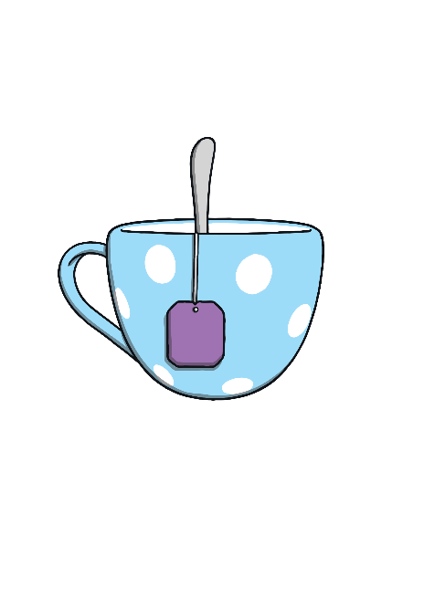
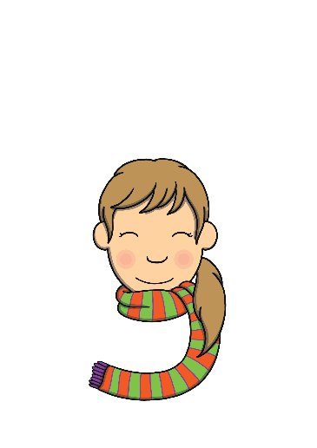
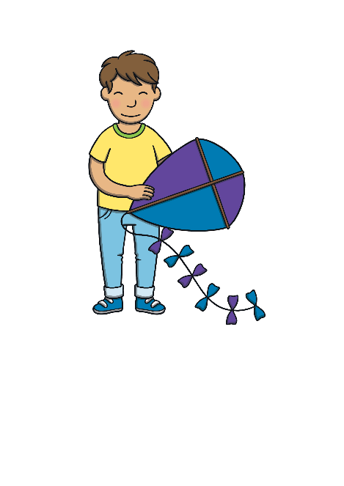
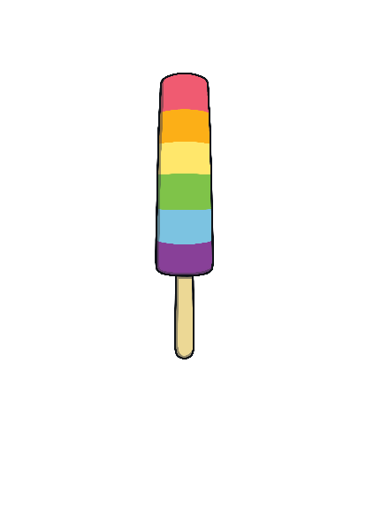
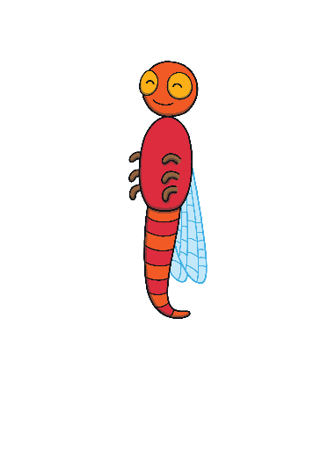
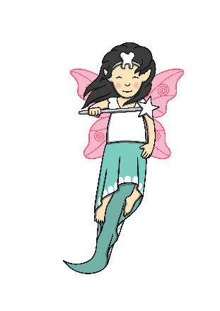
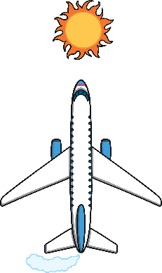
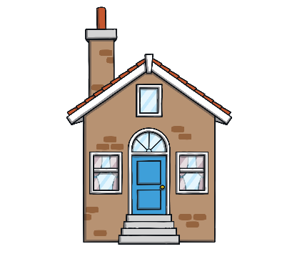
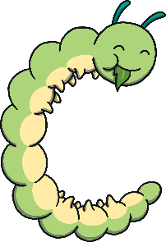
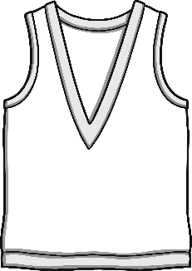
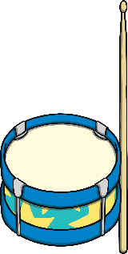
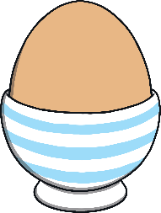
Revisit and Review
Let’s practise Sam’s Sounds and Tricky Words!
g
p
c
j
u
a
o
s
t
b
n
ck
m
v
r
i
k
f
ff
d
e
h
ll
ss
l
go
no
to
the
I

Slide 3
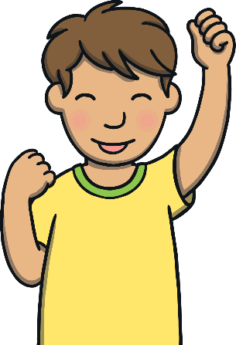
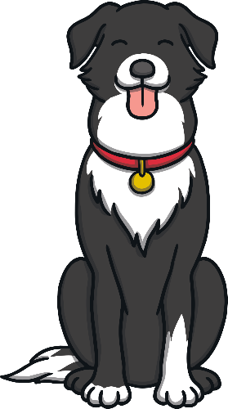
Sing the Alphabet
Revisit and Review
Can you sing this alphabet song along with Kit?
(To the tune of the traditional alphabet song)
A, B, C, D, E, F, G,
Sing the alphabet with me.
H, I, J, K, L, M, N,
Have a rest and start again.
O, P, Q, R, S, T, U,
Come along and sing it too.
Sing V, W, X and Y,
Z is last so say goodbye.
Play Song

Slide 4
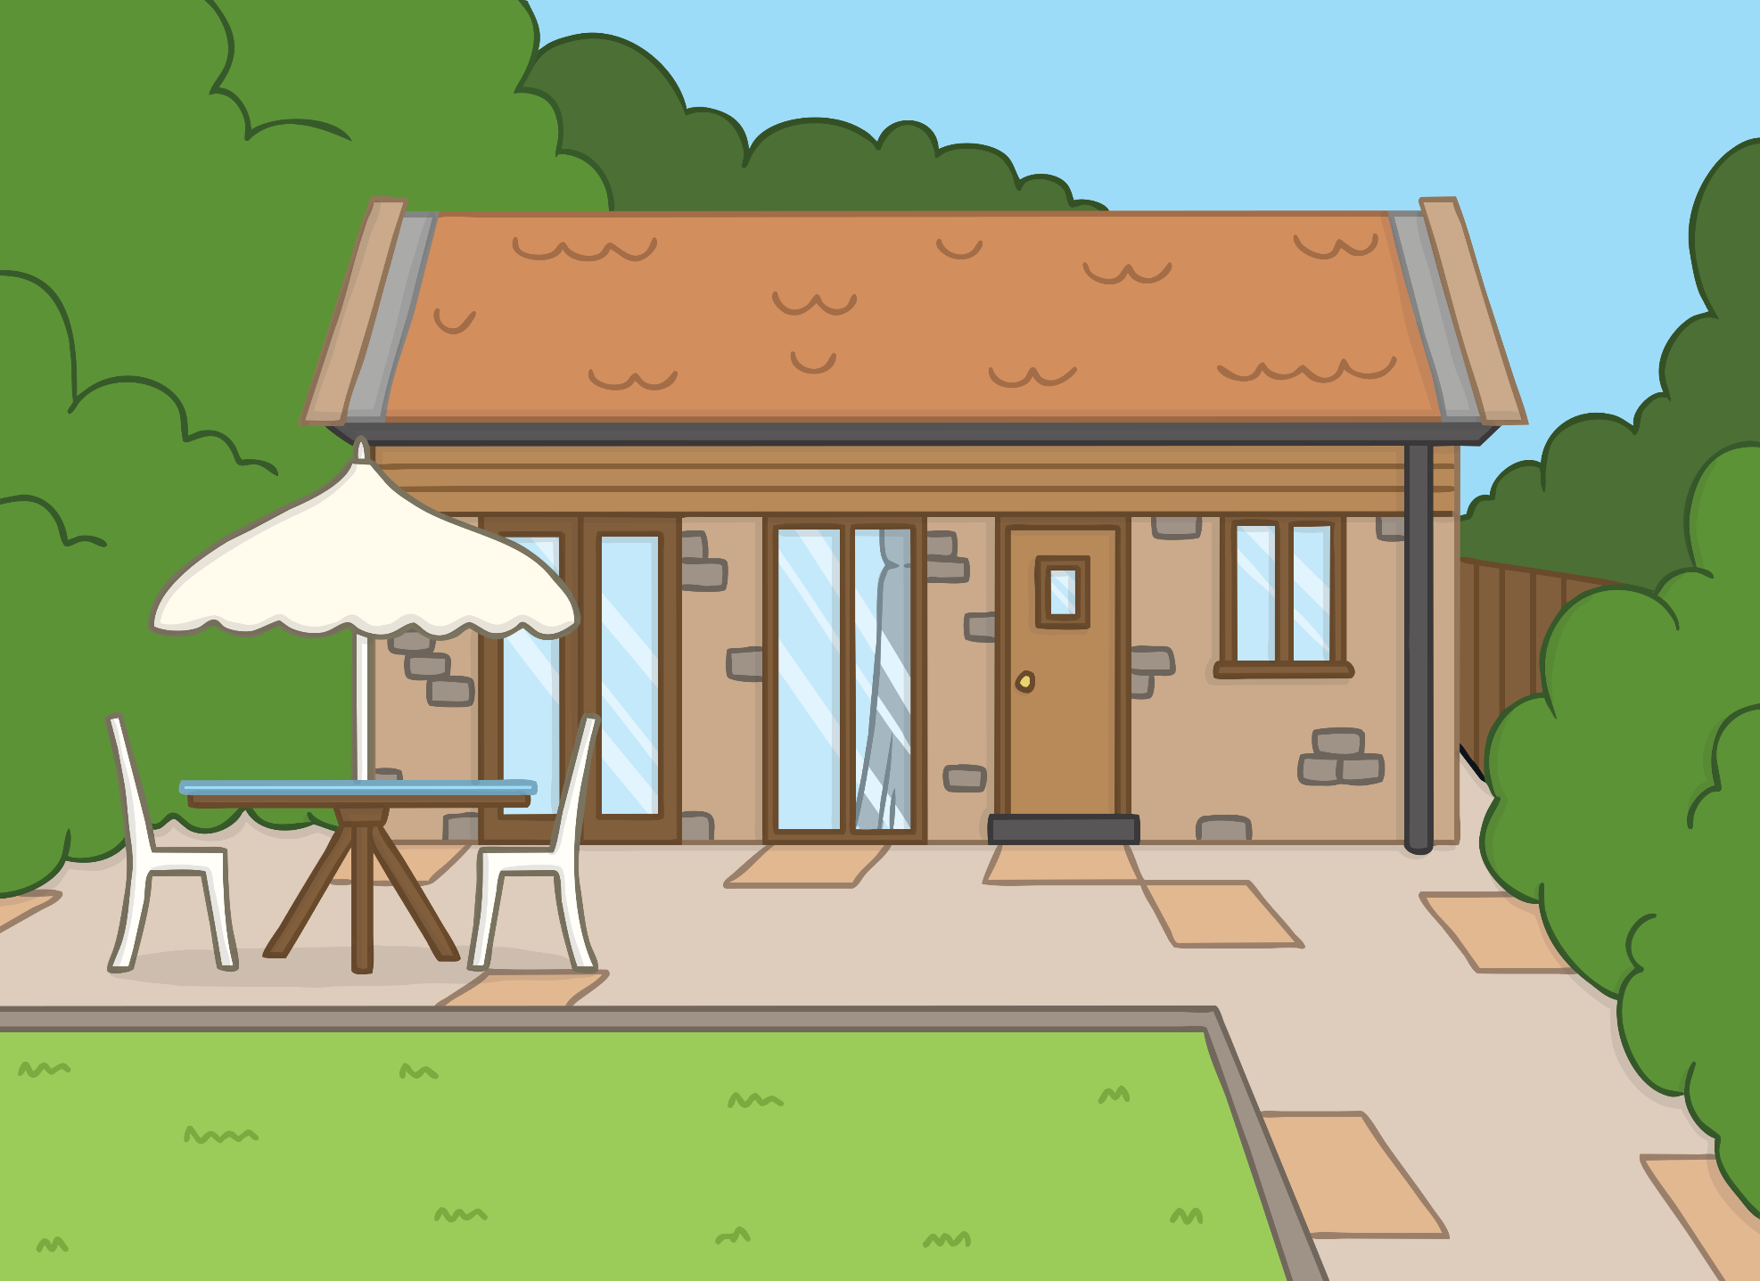
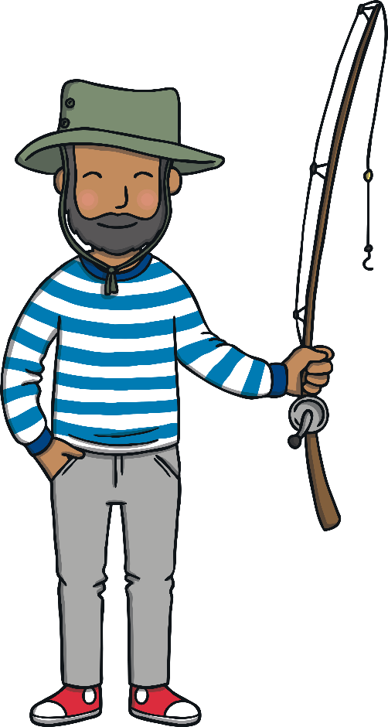
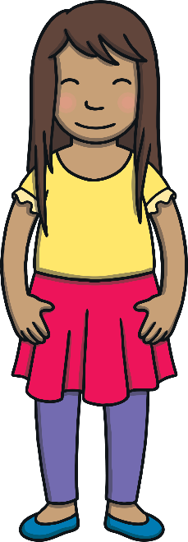
Teach
Kit and Sam are on holiday.
“Let’s go to the beach,” said Dad.
“Great idea!” said Kit and Sam. “We love going to the beach!”

Slide 5
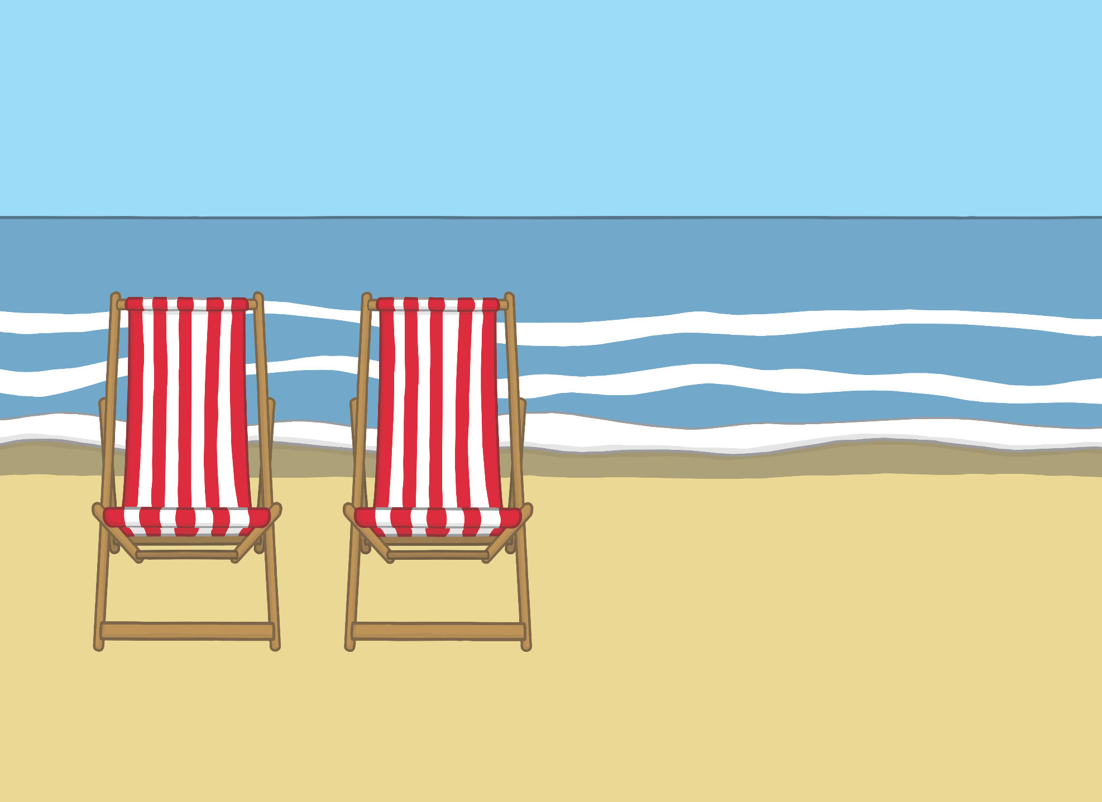
Teach
Kit and Sam ran straight to the sea. “Look at the gentle waves,” said Kit. “I love to watch them moving.”

Slide 6
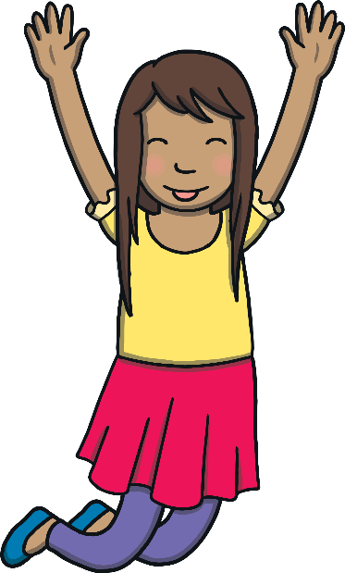
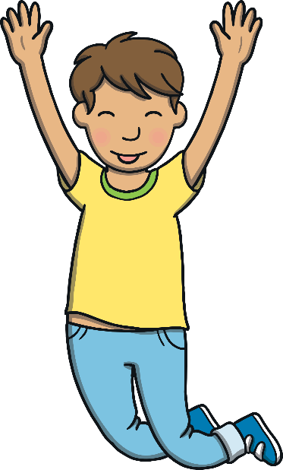
Teach
“Shall we try to jump over them?” asked Sam.
“Yes!” said Kit.
They both began to jump over the waves.

Slide 7
w
Teach

Slide 8
Teach
w

Slide 9
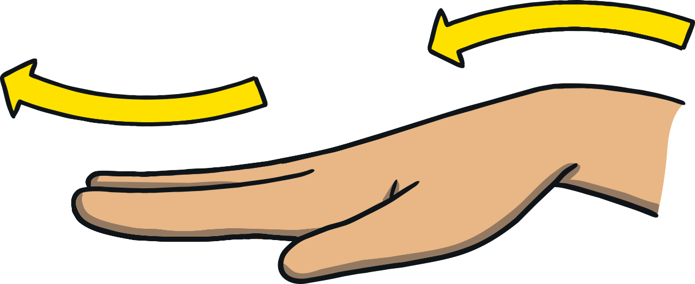
Action
Teach
Make waves with your hand.
Say ‘w, w, w’.

Slide 10
Write the Letter
w
Teach
Down the wave, up the wave, down the wave, up the wave.
Play

Slide 11
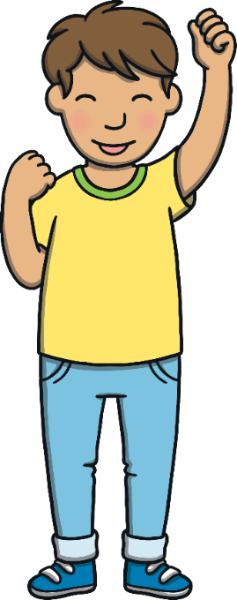
Let’s Sing!
Teach
(To the tune of ‘Baa, Baa, Black Sheep’)
Watch the gentle waves upon the sea.
w – w – w – w
One, two, three.
Up in the air and down on the sand.
We like to feel the water cold in our hand..
Play Song

Slide 12
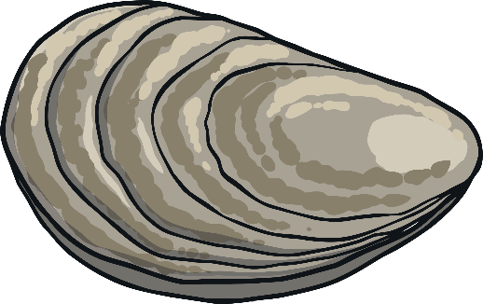
Shells in the Waves
Teach
Kit and Sam have found some shells on the shore. Can you use the shells to make a word that matches the picture?

Slide 13
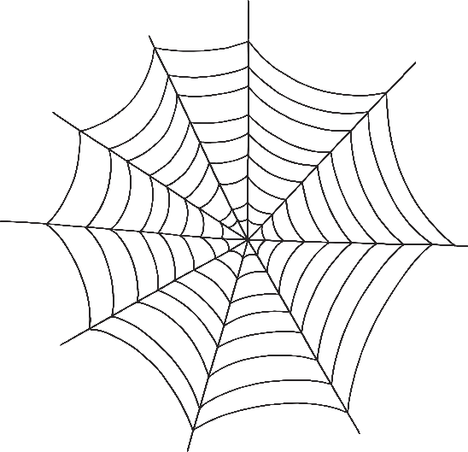
Teach
e
w
b

Slide 14
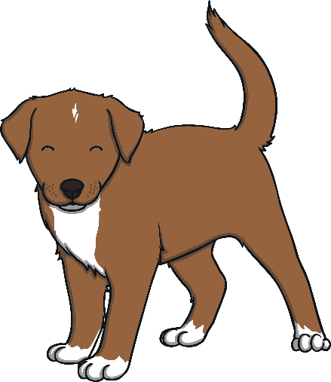
Teach
g
a
w

Slide 15
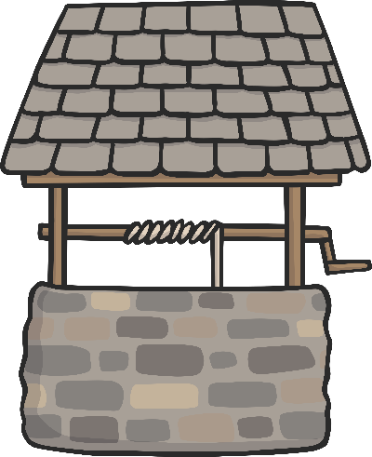
Teach
e
w
ll

Slide 16
Teach
w
i
n

Slide 17
Teach
i
ck
w

Slide 18
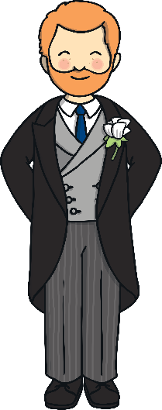
Teach
d
w
e

Slide 19
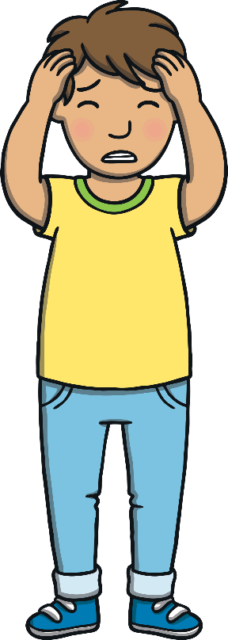
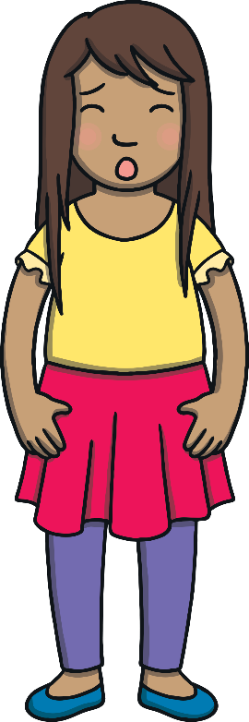
Apply
Suddenly, Dad shouted, “Oh no! My hat is blowing away!”
Kit and Sam stopped jumping and watched as the hat blew towards them.

Slide 20
Sentence Time
Apply
What happened to Dad’s hat? Write a sentence or caption to match what is happening in the picture.
X
Click ‘Sound Buttons On/Off’ to select whether you want show sound buttons under the caption.
Click me for Kit’s teaching tips!

Slide 21
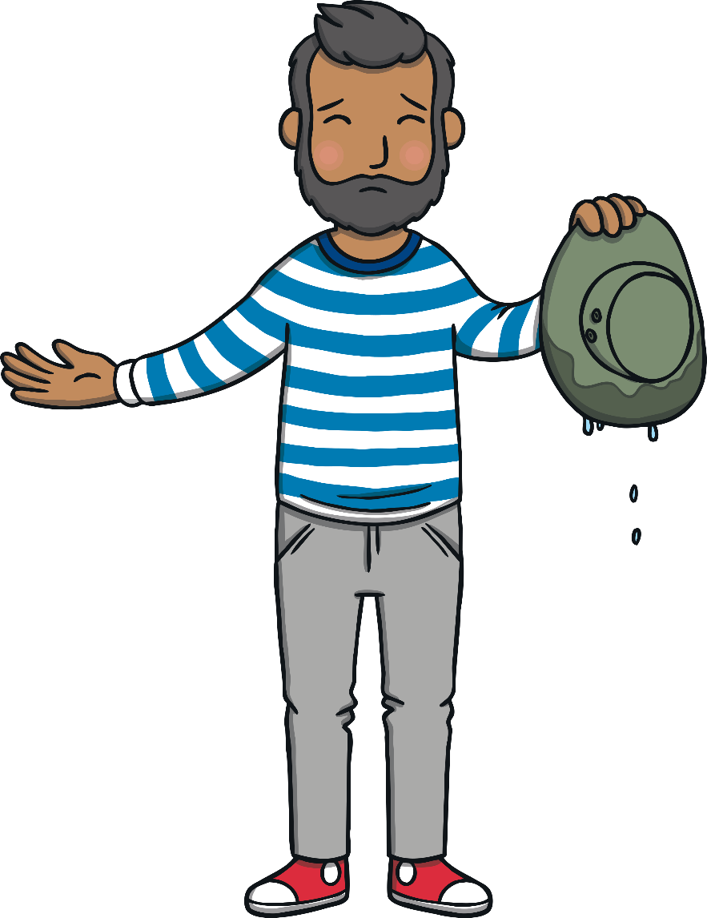
Apply
The hat got wet.
Sound Buttons On/Off
Show

Slide 22
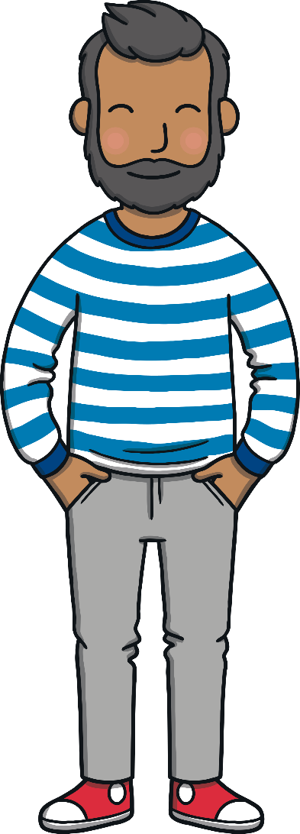
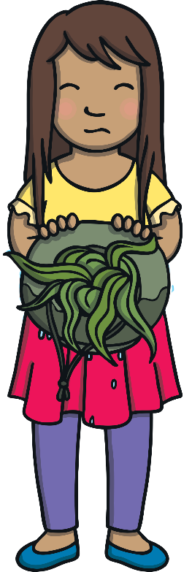
Apply
Kit and Sam fished the hat out of the water. It was full of seaweed.
“Thank you,” said Dad. “At least my hat caught something!”

Slide 23
Today, we have learnt…
Apply
w

