Slide 1
Lesson Two Gaining knowledge about what Stonehenge is

Slide 2
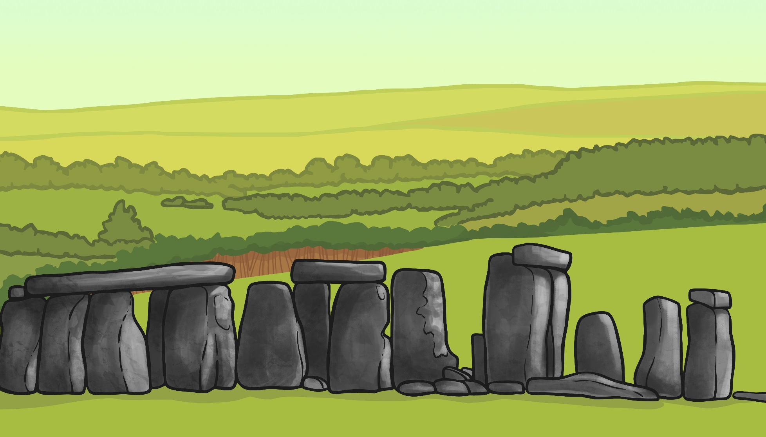
An Introduction to Stonehenge
Stonehenge is a very famous prehistoric monument in the South of England, in Wiltshire. It was started 5000 years ago during the Stone Age, around 3100 – 3000 BC. Up to 150 people were buried there when it was just an earthwork. The stones that we see today were added later.

Slide 3
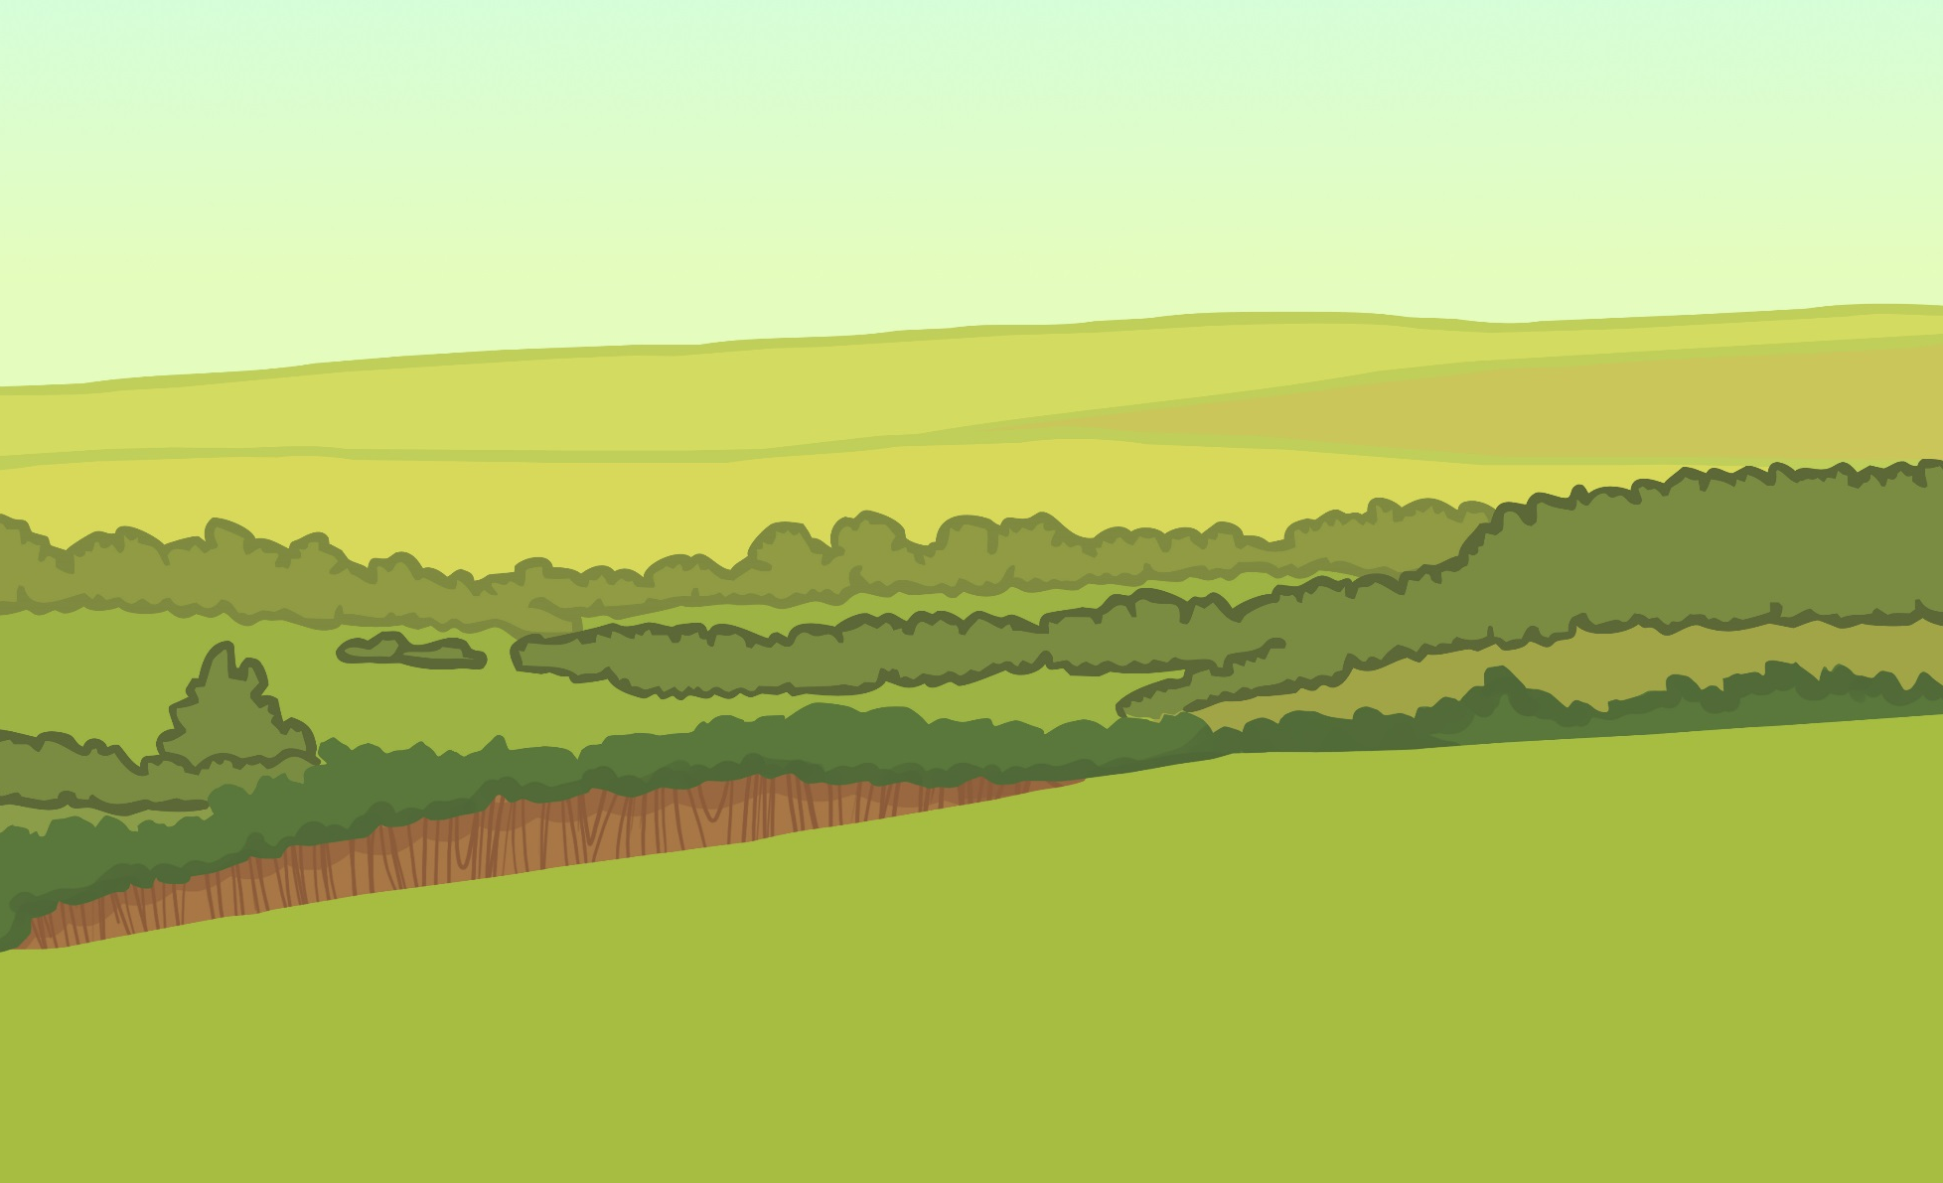
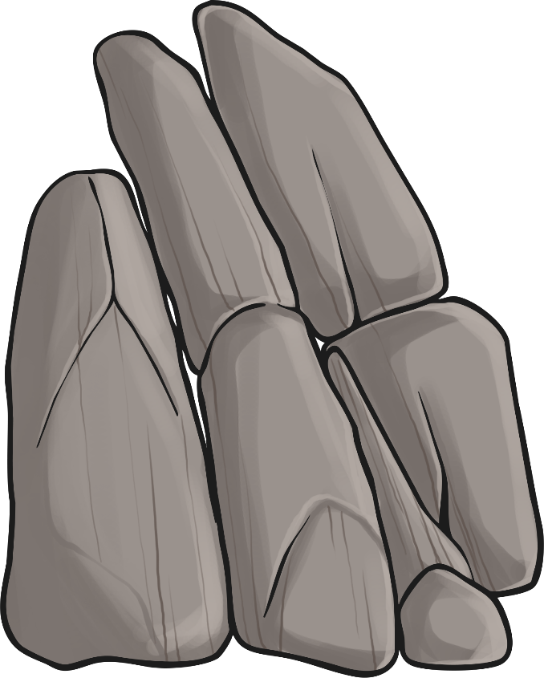
It is unclear when the second stage started, it could have been between 4000 and 5000 years ago. The stones that were added at this point came all the way from the Preseli Hills in South Wales. They were called bluestones (because they appear to be slightly blue when broken or wet) and 82 of them, weighing up to 4 tonnes each, were transported an amazing 240 miles over land and water.
This is way before roads and lorries!
The stones were around 2m tall and over 1m wide. They were set up in a double circle pattern. During this second stage, the north-east entrance was widened and the largest stone, known as the Heel Stone, was added. The Avenue was started. This was an earth corridor dug to connect Stonehenge with the River Avon.

Slide 4
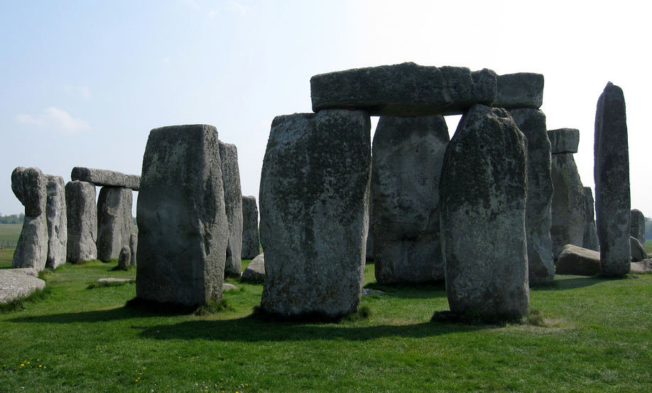
The third stage involved the addition of more stones about 500 years later. These were called Sarsen stones and came from the Marlborough Downs, about 25 miles from Stonehenge. The Sarsen stones were enormous, the upright stones being over 4m high, 2m wide and weighing up to 30 tonnes! An outer circle was created, with stones laid horizontally across the top.
Photo courtesy of nyaa_birdies_perch (@flickr.com) – granted under creative commons license - attribution.

Slide 5
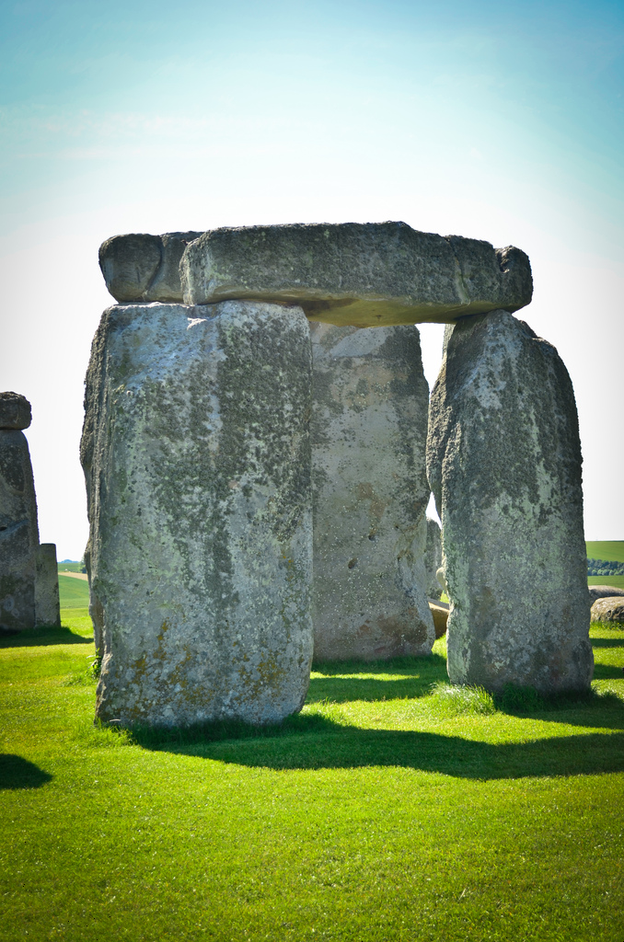
Medieval gallows were built with two vertical stones and a horizontal stone on top, which is why the name Stonehenge could be derived from the Old English words for ‘stone’ and ‘hang’
Photo courtesy of LitasWorld(@flickr.com) –
granted under creative commons license - attribution.

Slide 6
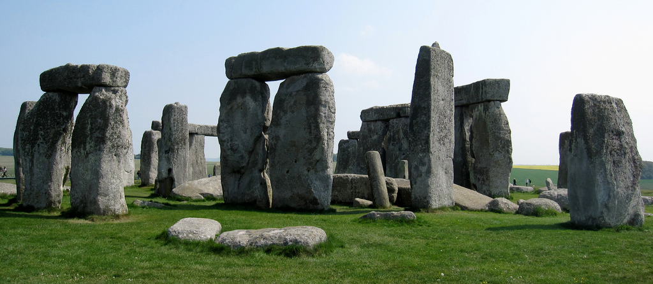
In the middle, more stones were arranged in a horseshoe shape. At the centre was a stone called the Altar Stone. It has now fallen over, but was thought to have been a single, vertical stone.
During the final changes, the original bluestones were rearranged into the horseshoe and circle shape that can be see today.
Photo courtesy of nvaa birdies perch(@flickr.com) – granted under creative commons license - attribution.

Slide 7
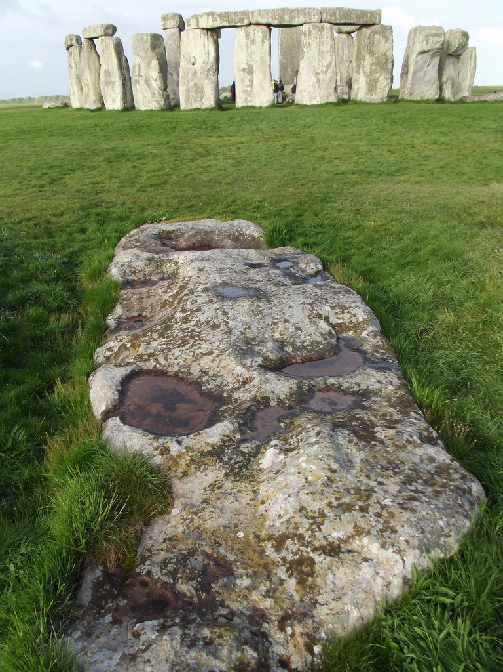
The slaughter Stone is a type of sandstone which, after rain, can appear to have a reddish colour. This is because the iron in the stone reacts with the rainwater. It was called the Slaughter Stone by Victorians who assumed that the red in the stone was blood, and thought that Druids must have practiced sacrifices on it.
Photo courtesy of LitasWorld(@flickr.com) –
granted under creative commons license - attribution.

Slide 8
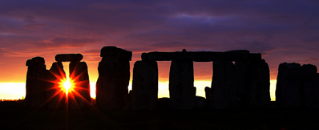
The stones are positioned very carefully to align with sunrise at midsummer and sunset at midwinter at opposite ends of the circle.
Photo courtesy of Peter G Trimming (@flickr.com) – granted under creative commons license - attribution.

