Slide 1
rainforest a to z
Phoebe Edwards, Maple Class

Slide 2
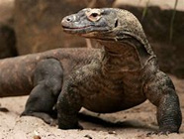
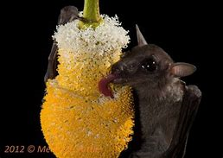
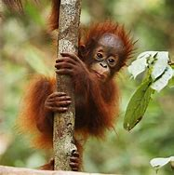
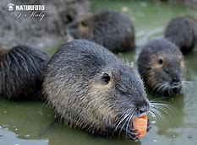
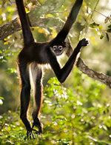
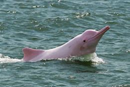
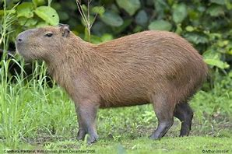
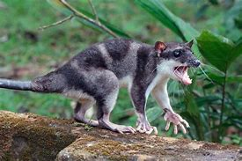
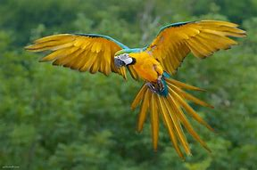
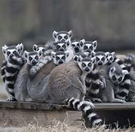
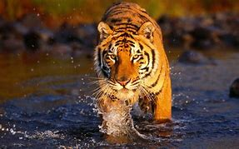
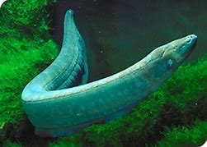
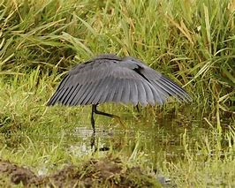
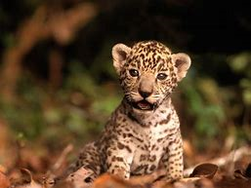
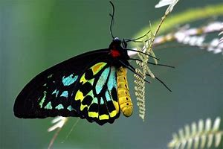
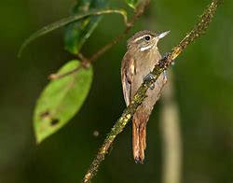
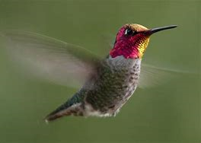
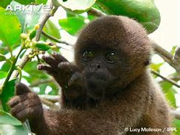
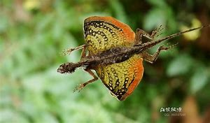
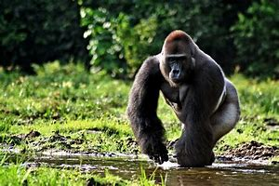
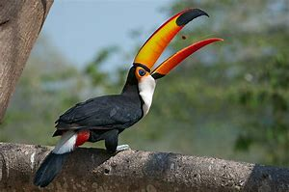
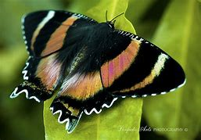
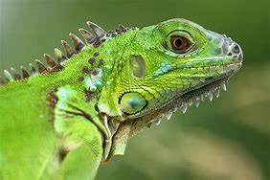
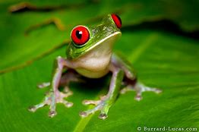
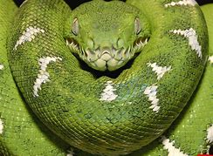
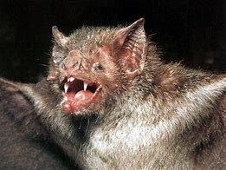
RAINFOREST A TO Z QUIZ: Can you match the animal to the picture?
Alphabet | Animal
A | Anaconda
B | Bengal tiger
C | Capybara
D | Dawn bat
E | Electric eel
F | Flying dragon
G | Gorilla
H | Hummingbird
I | Iguana
J | Jaguar
K | Komodo Dragon
L | Lemur
M | Macaw
N | Nutria
O | Orangutan
P | Pink dolphin
Q | Queen Alexandra’s Birdwing
R | Red-eyed tree frog
S | Spider monkey
T | Toucan
U | Umbrella bird
V | Vampire bat
W | Woolly monkey
X | Xenops
Y | Yapok
Z | Zodiac moth
Answers on the next page!

Slide 3
RAINFOREST A TO Z QUIZ: Can you match the animal to the picture?
Alphabet | Animal
A | Anaconda
B | Bengal tiger
C | Capybara
D | Dawn bat
E | Electric eel
F | Flying dragon
G | Gorilla
H | Hummingbird
I | Iguana
J | Jaguar
K | Komodo Dragon
L | Lemur
M | Macaw
N | Nutria
O | Orangutan
P | Pink dolphin
Q | Queen Alexandra’s Birdwing
R | Red-eyed tree frog
S | Spider monkey
T | Toucan
U | Umbrella bird
V | Vampire bat
W | Woolly monkey
X | Xenops
Y | Yapok
Z | Zodiac moth
K
D
N
P
O
S
C
Y
L
M
B
E
J
U
Q
X
H
W
F
G
T
Z
I
A
R
V
How many did you get? Go to the next page to see your rank!

Slide 4
Your Score | Your rank
Zero | Got eaten alive!
One to nine | Lost in the jungle!
Ten to twenty | Jungle Detective!
Twenty to twenty-six | Super Explorer!
Doesn’t matter what you scored well done for trying☺

