Slide 1
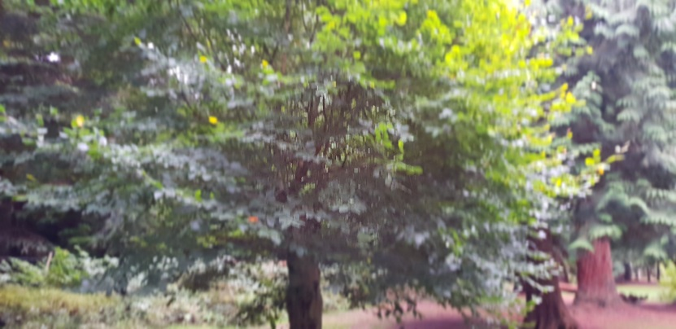
Maple Class Autumn term homework - Trees
By Phoebe-Mae

Slide 2
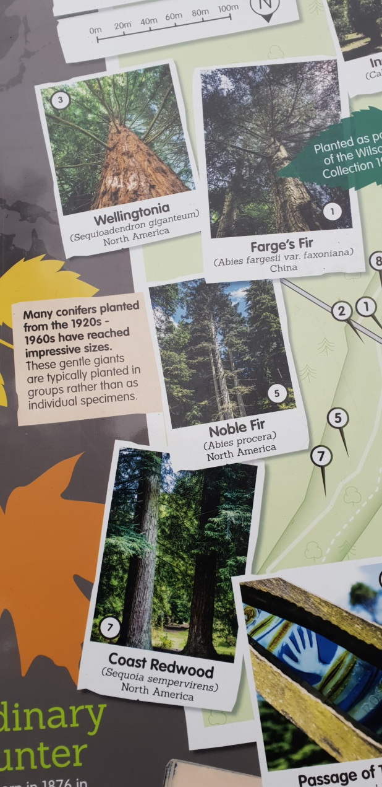
We went for a walk at the Cyril Hart Arboretum and saw lots of different trees. Some trees I knew and some I didn’t so I used the information board and the signs on the trees to identify them.

Slide 3
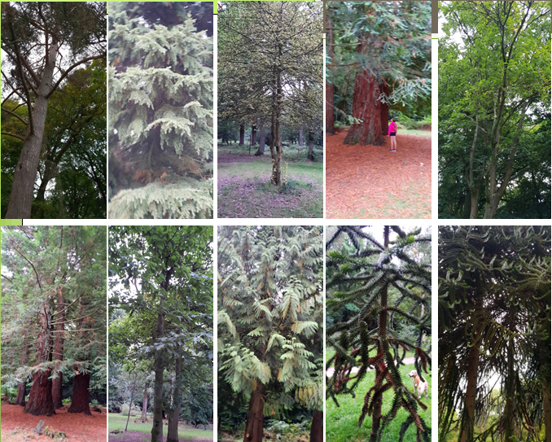
Gold Leaved Holly
Scots Pine
Mountain hemlock
Red Fir
Common Oak
Coast Redwood
Sycamore
Red Cedar
Monkey Puzzle
Chilean Pine

Slide 4
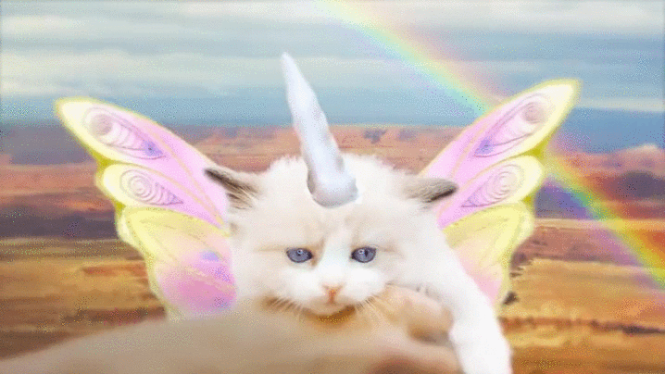
Thankyou for listening to me!

