Slide 1
Team GB

Slide 2
Sir Mohamed Farah Sir Mo Farah was born on the 23d of March 1983 however Mo Farah has recently retired from track racing but just because he has retired from track doesn't mean he has retired from team GB and running altogether. Mo Farah still runs for team GB just he does races on the road.

Slide 3
Bianca walkden Bianca started taekwondo at the age of 11 and started her junior career at 15 and she was born on the 29 September 1991. Bianca and jade jones are the only British practitioners to defend a global tittle.

Slide 4
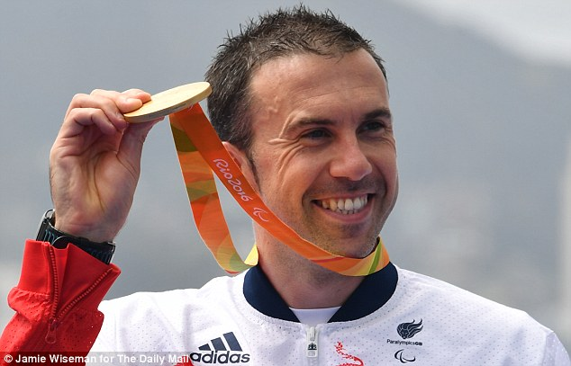
Andy Lewis
Andy was born on the 24 of January 1983.
Andy Lewis had to have his leg amputated when
he was only sixteen because he was involved in
a motorbike accident with a lorry.

