Slide 1
Sunflower Poetry
Similes and Adjectives

Slide 2
Learning Objective
To revise adjectives and similes.
Success Criteria
To be able to explain and give examples of similes and adjectives.
To be able to improve sentences using adjectives and similes.
To be able to create similes and choose adjectives.

Slide 3
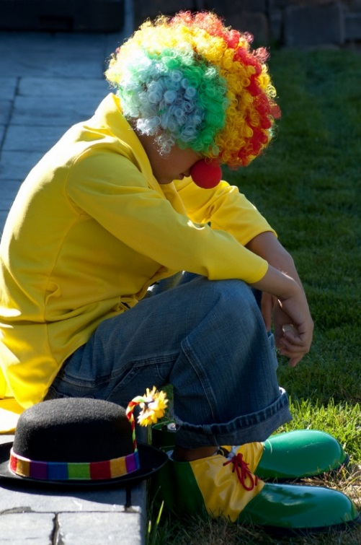
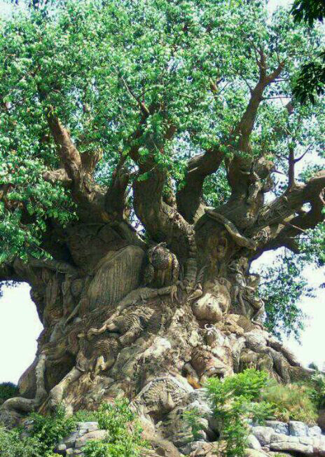
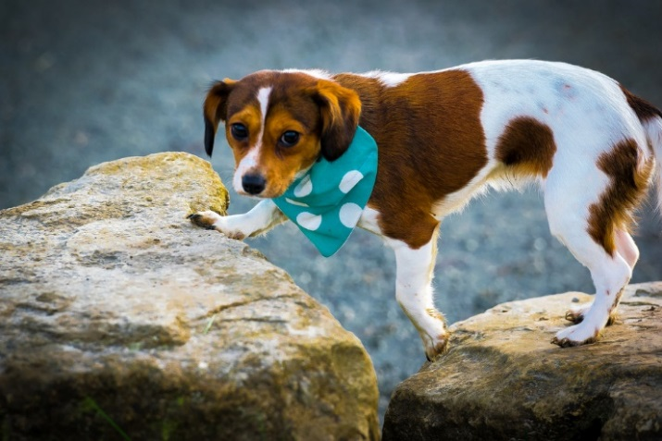
Finding Adjectives and Similes
Can you think of any adjectives to describe these pictures?
Can you think of any similes for the pictures?
Photo’s courtesy of shawncampbell, Bls Auto, Island Way Photography@flickr.com - granted under creative commons licence – attribution

Slide 4
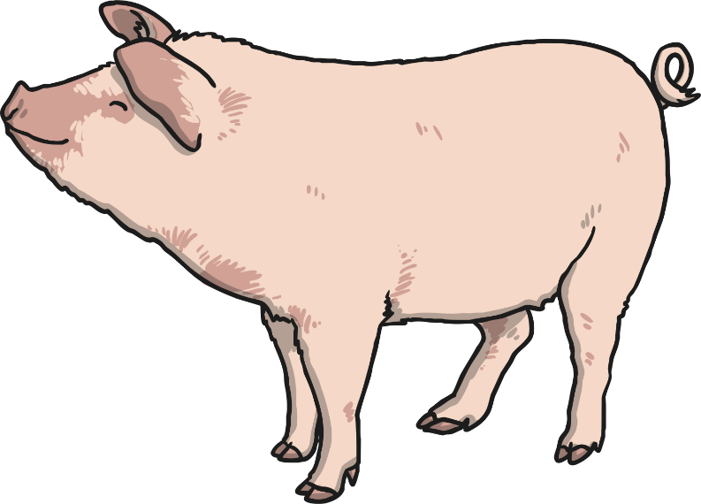
Simile Reminder
A simile is a way of describing something by comparing it to something else using ‘like’ or ‘as’.
For example:
Her eyes are like stars and her lips are like roses.
He was as fat as a pig.

Slide 5
Finish the Similes
Now you try:
The night was as black as…. ?
The fireworks were colourful like …. ?
The book was as boring as …. ?
Greece was hot like …. ?
The doll’s face was as smooth as …. ?

Slide 6
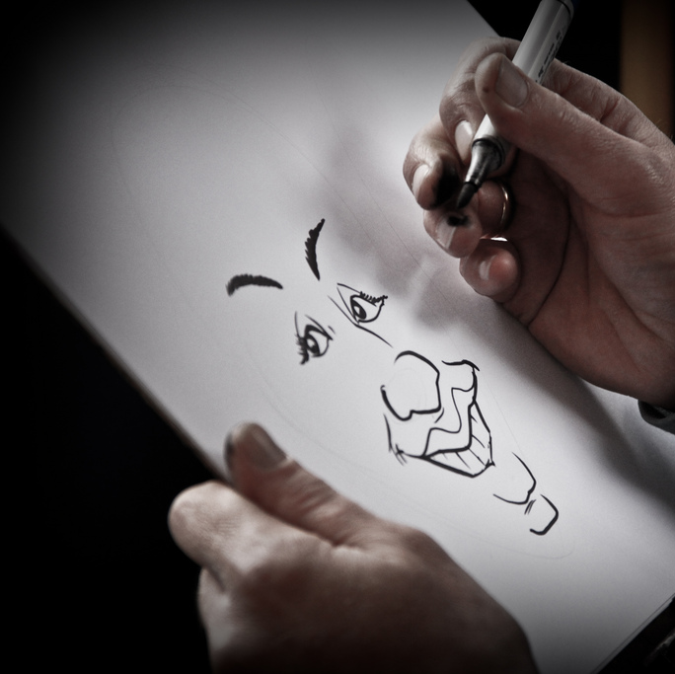
Why Do We Use Similes and Adjectives?
When you are describing something, you are trying to create a picture in the reader’s mind. Similes can help you to do this.
They are most often used in stories and poems.
Photo’s courtesy of Natesh Ramasamy@flickr.com - granted under creative commons licence – attribution

Slide 7
See How it Works
The dog was big and fierce.
Now if we add adjectives and similes…
The black, scruffy dog was as big as a wolf and fierce like a very angry bear.
Isn’t that better?

Slide 8
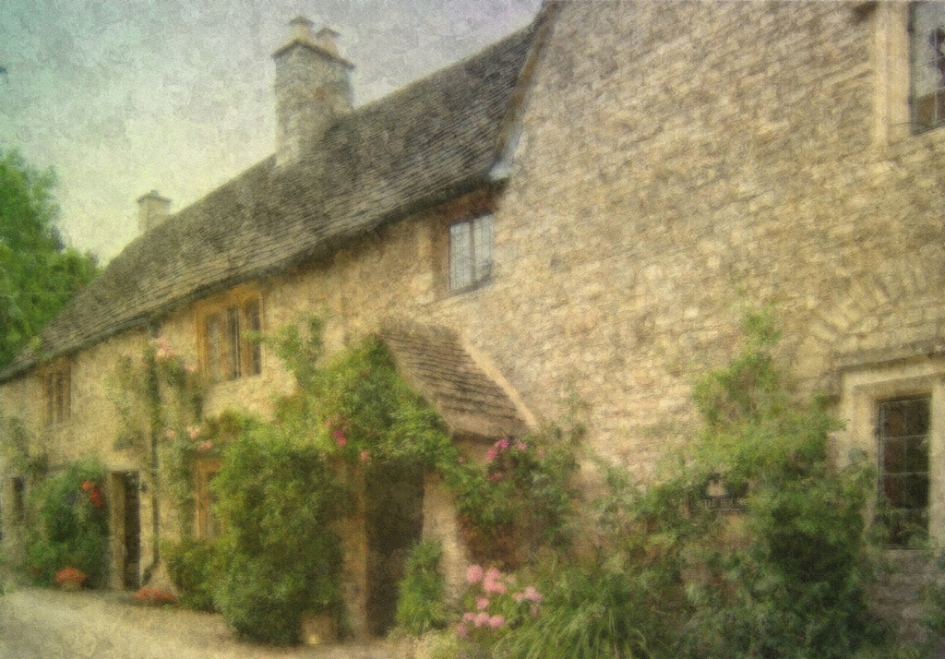
Or…
The house was beautiful.
The ancient house was beautiful like an old-fashioned painting.
Photo’s courtesy of digitalrob70@flickr.com - granted under creative commons licence – attribution

Slide 9
Improve these Sentences
…
Where you see: put in an adjective put in a simile
*
The * lady had a voice like a …
The cat was * and * and ran like a …
The * prince asked the * princess to marry him. She was as happy as a …

Slide 10
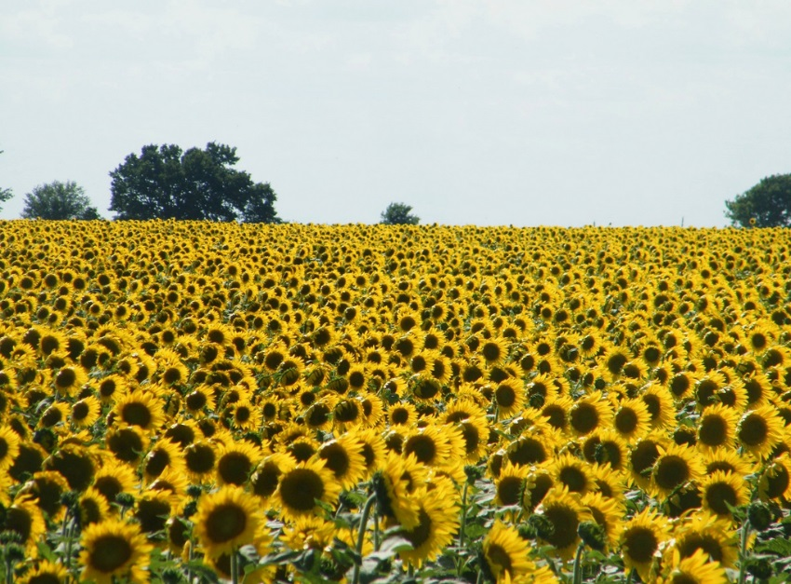
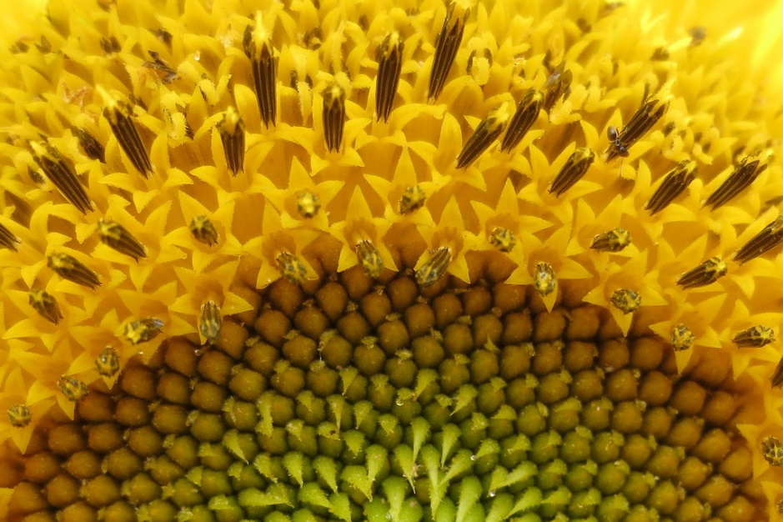
What about Sunflowers…?
By the time you have finished this project, you will have created your own sunflower poem, and this is the first step on that journey.
Photo’s courtesy of ted_M8, inthepotter'shands@flickr.com - granted under creative commons licence – attribution

Slide 11
Create Your Own
On the next few slides you’ll see some pictures of real sunflowers.
It’s your job to write at least three adjectives and at least three similes about the sunflowers.
Remember to try to think of words that are exciting and unusual. Use a thesaurus to help.
Try to turn your ideas into a poem.
Words to avoid: yellow, green, tall, pretty, nice, bright, good.

Slide 12
Photo’s courtesy of ted_M8@flickr.com - granted under creative commons licence – attribution

Slide 13
Photo’s courtesy of NAPARAZZI@flickr.com - granted under creative commons licence – attribution

Slide 14
Photo’s courtesy of Mmacieklew@flickr.com - granted under creative commons licence – attribution

Slide 15
Photo’s courtesy of Moyan_Brenn@flickr.com - granted under creative commons licence – attribution

Slide 16
Photo’s courtesy of visualdensity@flickr.com - granted under creative commons licence – attribution

Slide 17
Photo’s courtesy of peddhapati@flickr.com - granted under creative commons licence – attribution

Slide 18
Photo’s courtesy of whitepebbles@flickr.com - granted under creative commons licence – attribution

Slide 19
Photo’s courtesy of DrPhotoMoto@flickr.com - granted under creative commons licence – attribution

Slide 20
Quiz

Slide 21
Which word is an adjective?
Jumping
Palace
Amazing
Happily
Well done!

Slide 22
Why do we use similes?
To make our writing sound good.
To create a picture for the reader.
We get better marks for it.
Our teacher wants to make life difficult.
Correct!

Slide 23
Which of these is a simile?
She’s as big as a ship in full sail.
The moon was a pale, silver coin in the sky.
The angry waves climbed the sea wall.
The wolf-like baby was howling.
Spot on!

Slide 24
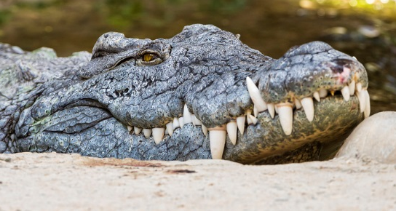
Pick the best adjective…
…to describe the teeth in the picture. Give reasons.
Nasty
Razor-sharp
Pointy
Awful
Well done!
Photo’s courtesy of Tambako the Jaguar@flickr.com - granted under creative commons licence – attribution

