Slide 1
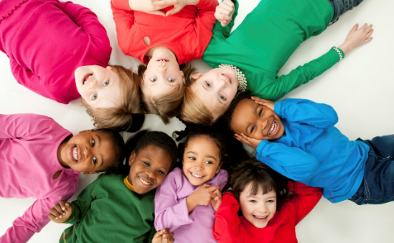
The children’s society

Slide 2
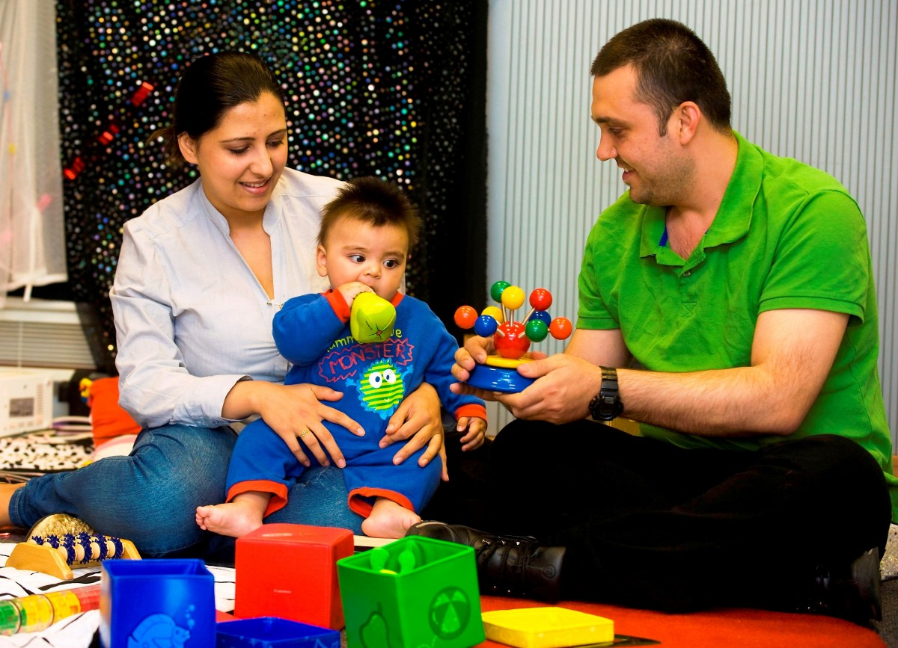
The children’s society go to other places in Britain to STOP poverty happening.
The children’s society help children get above the poverty line!
What does this actually mean?

Slide 3
What is poverty?
Being above the poverty line means you have a safe life. For example, you have somewhere warm and safe to live. You have enough food and drink. You go to school regularly and you have a nice life.
Poverty line
Being under the poverty line means you don’t have a safe place to live. For instance, you might not have a house, your house might be very cold because your parents can’t afford to heat it, you might not go to school regularly, you might not have enough to eat and drink.

Slide 4
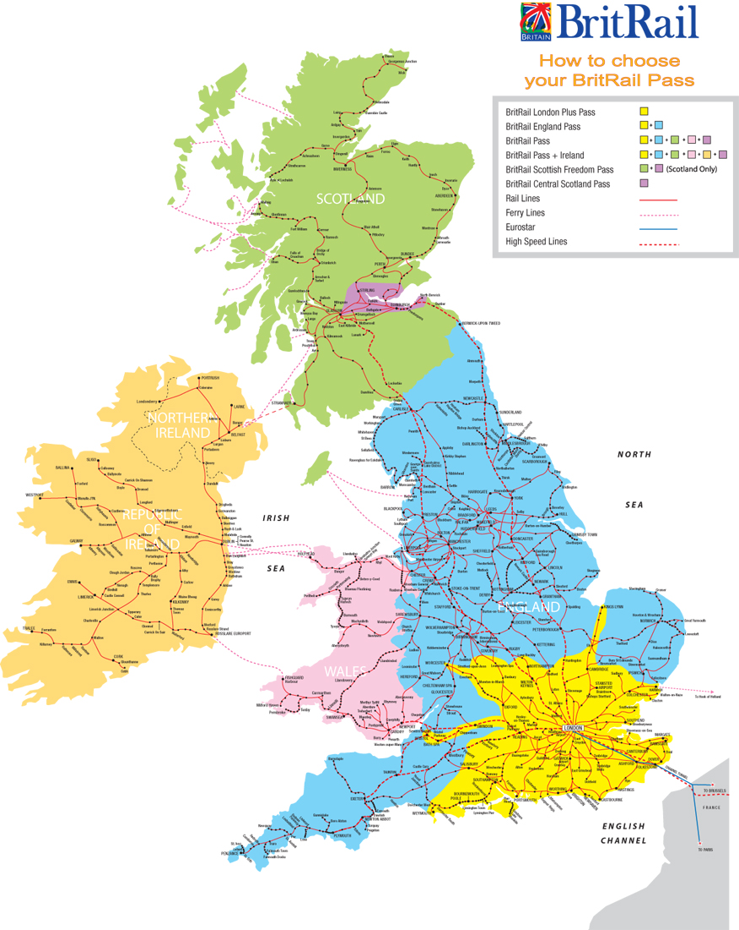
The children’s society help a lot of people in Britain .

Slide 5
Pick the children’s society they help other children your age!

